Slide 1
Interreg C-Care Project Closing Event – Canterbury, Kent
1-2 March 2023 (Future Work Skills: equipping the worforce (Skills, Training, Self-Employment, Start-Ups and Apprenticeships)

Slide 2
Who are we?
New Anglia Local Enterprise Partnership works with businesses, local authority partners and education institutions to drive growth and enterprise in Norfolk and Suffolk..
NALEP previously delivered a £28m ERDF business advice service, including economic support for high value business start-ups.

Slide 3
The Challenge
Situation Analysis
(What need / challenge is the reviewed activity responding to)
Offer an alternative to furlough/unemployment to those affected as a result of COVID
Objective(s)
(What is the activity aiming to achieve? (changes/impact on the economy, society, environment, etc – the Project’s themes)
To furnish potential entrepreneurs with the skills and knowledge to make informed career and financial choices through self-employment

Slide 4
The Challenge contd.
Description
Description of the activity / action / programme that is being reviewed
– what is involved (procedures, networking, co-operations)
- who is involved ( (target groups / partners / stakeholders)
- delivery methodology (tools used, communication and promotion, etc)
- results monitoring (data capture and analysis)

Slide 5
What were we looking to achieve?
Output Type | Target
Engagements | 1200
Participants completing | 620
Business Starts | 300
Jobs Created | 60
Case Studies | 6
Fact Sheets | 4

Slide 6
What Support was available?
Plan Thinking of Starting a Business? Initial considerations and first steps Business Planning skills Workshop Initial Diagnostic Business Skills Builder Modules Undertaking Market Research 1 to 1 Coaching | Start Marketing Skills Introduction to Social Media Digital Transactions and e-commerce 1 to 1 Coaching
Run Sales Skills Be a better communicator Customer Service Skills Book-keeping Business Builder modules Wellbeing and Resilience Peer support FactSheets/Guides 1 to 1 or Small group Coaching | Grow Ambition to Employ 1 to 1 or Small group Coaching
Through Facilitated Zoom Sessions, 1 to 1 calls and self-learning using existing/curated content

Slide 7
How did we do?
Output Type As at 21.02.2023 | Achieved
Engagements | 847 (71%)
Participants completing | 482 (78%)
Business Starts | 165 (55%)
Jobs Created | 41 (68%)
Case Studies | 4 (67%)
Fact Sheets | 6 (150%)

Slide 8
Thank you!
Michael.sargent@newanglia.co.uk
Julie.west@newanglia.co.uk

Slide 9
Interreg C-Care Project Closing Event – Canterbury, Kent
1-2 March 2023 (Future Work Skills: equipping the workforce)

Slide 10
Access to Apprenticeships (A2A)
Background Context
Norfolk was rated (bottom 20%) as a social mobility cold spot (Social Mobility Index, 2016)
Opportunities for young people were limited and highly competitive as a result of the Covid19 pandemic; with those aged 16-24 disproportionately disadvantaged, in starting an apprenticeship (DfE data, 2020)
For some, travel costs, and the cost of necessary equipment & materials is a major barrier stopping them from taking on an apprenticeship (Redrow, 2019).
77% of businesses identified cashflow as a primary challenge (Norfolk Chambers of Commerce, 2020).
A2A builds on a previous programme, Recruit | Retain | Reward (RRR) which offered incentive payments to businesses for costs associated with apprenticeship delivery
76% of businesses survey stated that the availability of financial incentives is ‘extremely’ or ‘somewhat important’ in their decision to take on a young apprentice (RRR survey evaluation, NCC 2020)
Notes:
Norfolk was rated as a social mobility cold spot (bottom 20%) in the 2016 Social Mobility Index, which identifies that ‘Many of these areas perform badly on both educational measures and adulthood outcomes, giving young people from less advantaged backgrounds limited opportunities to get on.’

Slide 11
Access to Apprenticeships (A2A)
The A2A grant
Access to Apprenticeships (A2A) aimed to support increased social mobility, ensuring financial barriers to apprenticeship opportunities were removed for individuals, particularly following the Covid-19 pandemic
A2A grants improved the opportunity for those aged 16-24, to be able to start an apprenticeship with a small to medium sized business in Norfolk.
The bursary grant, of up to £500, helped young people to access funding to:
Digital equipment/connectivity to enable completion of online learning or ePortfolio work
The cost of travel expenses to get to learning provider or place of work
Equipment they need to start work in a specific trade (e.g. chef knives, construction tools, hairdressing scissors)

Slide 12
Access to Apprenticeships (A2A)
Case Study:
BH Trees Ltd

Slide 13
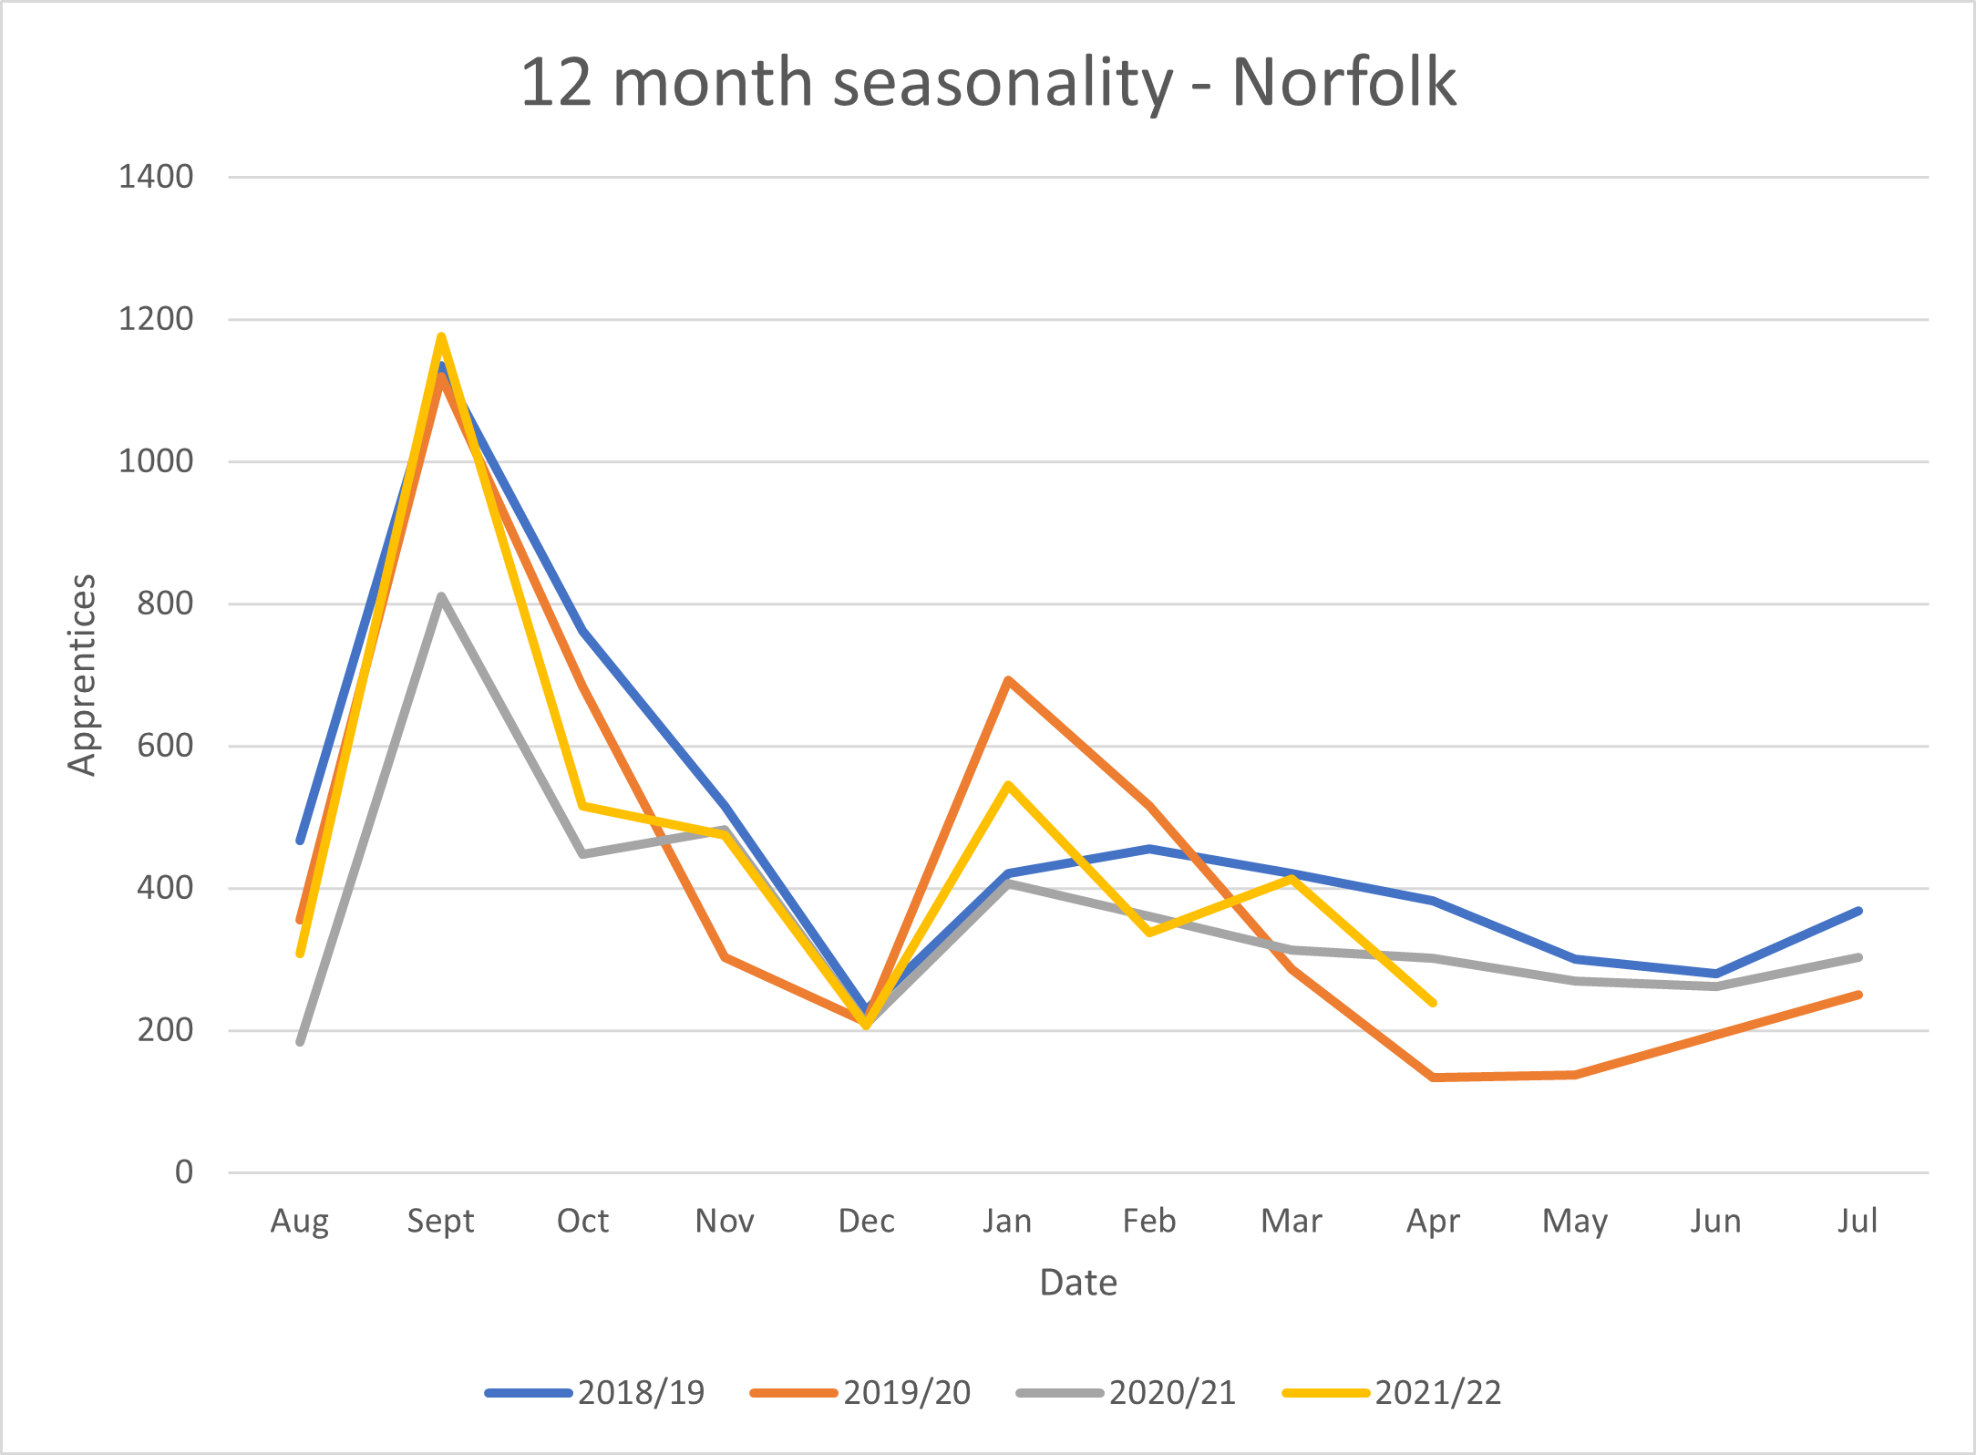
Access to Apprenticeships (A2A)
Automation context
Apprenticeships have large seasonal peaks
Project launched in December – took a while to gain momentum (expected)
Anticipated high volume of applications during August, September & October
Needed to maximise staffing resource capacity

Slide 14
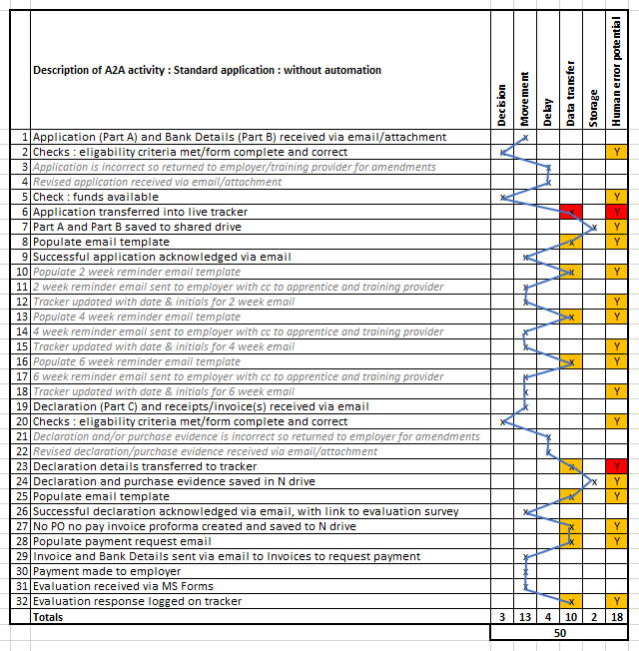
Access to Apprenticeships (A2A)
Automation of administrative processes
Processing applications was time consuming and we identified areas of process ‘waste’:
Excessive movement of data
Errors submitted created waiting time/unplanned activity
Overproduction
Opportunity for human error
Notes:
Excessive movement of data (between emails, spreadsheets and file storage)
Errors submitted created waiting time (and subsequent unplanned activity)
Overproduction (manual reminders, double entry for processing and payments, manual reporting)
Opportunity for human error

Slide 15
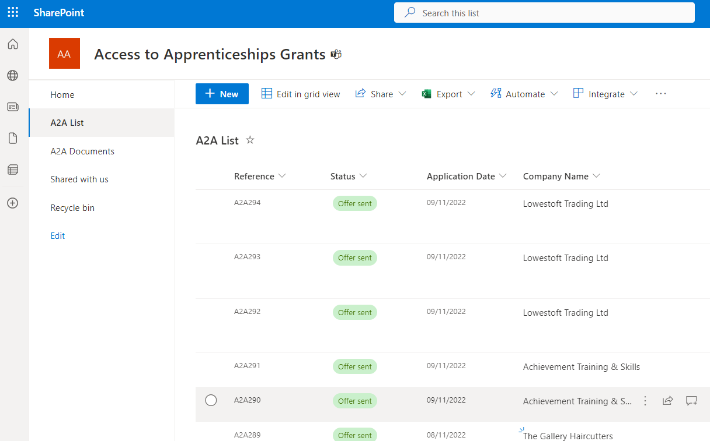
Access to Apprenticeships (A2A)
Automation of administrative processes
Word application forms vs webforms
SharePoint List
Automated emails, file storage & invoice proformas

Slide 16
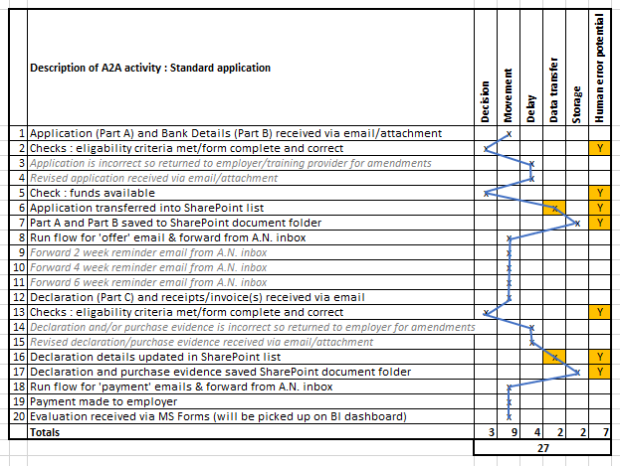
Access to Apprenticeships (A2A)
Automation – benefits
Reduction in:
manual processing
opportunity for human error
resource requirement
(13 hours per month saved!)

Slide 17
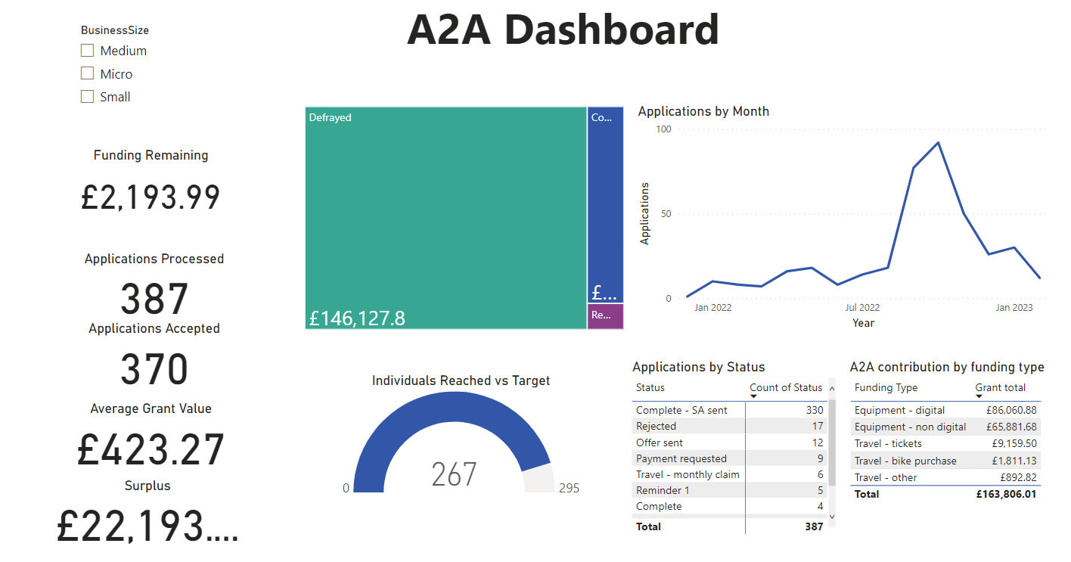
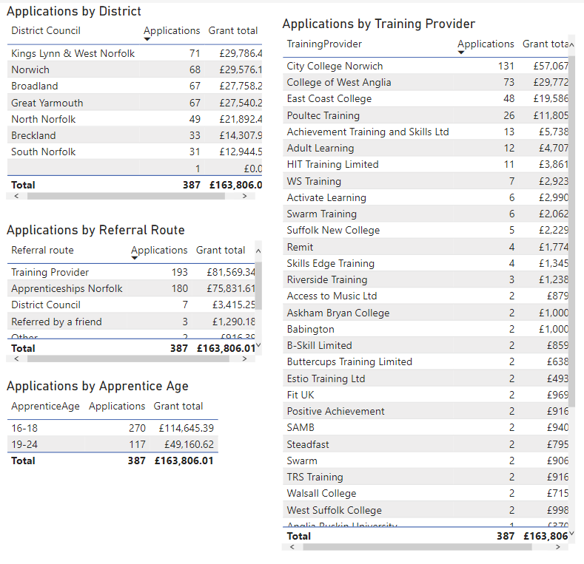
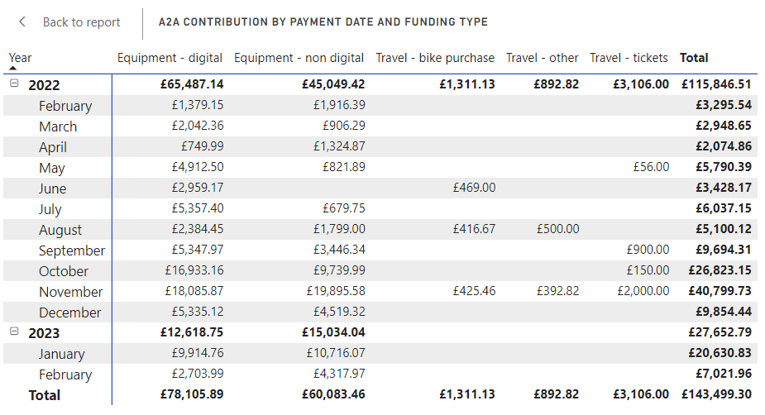
Access to Apprenticeships (A2A)
Automation – other benefits
Automated reporting via PowerBI

Slide 18
Access to Apprenticeships (A2A)
Case Study:
Little Lifts

Slide 19
Access to Apprenticeships (A2A)
Results (at time of writing)
371 financial grants completed
268 individuals supported
Average grant value £423.27
Grants were paid on ‘immediate terms’ rather than standard 30 days, as Covid19 response (cashflow)
Grants were offered in all seven districts in Norfolk
Engineering & Construction = highest applications by sector
70% of grants = aged 16-18
30% of grants = aged 19-24
Training providers were main source of referrals
Mainly supported Level 2&3 apprentices
Mainly supported digital equipment
Contributed to increase in apprenticeship starts in Norfolk, for the first time following 5 years of decline!
ROI = 371 apprenticeships > c£80m economic ROI*
Lessons learned from automation > new projects
*Calculation:
RoI = outputs x per £ of apprenticeship funding (average value in Norfolk, 2021/22) x average £ of ROI (DfE calculation)
RoI = 371 x £7945.00 x £27.00

Slide 20
Access to Apprenticeships (A2A)
Evaluation Comments - Employers
“In a difficult post pandemic business environment, these grants have enabled us to recruit and train the next generation of new staff for the business, and demonstrates to her we are serious about her career and I firmly believe this support will go along way to attracting / retaining good staff”
“It was really beneficial for our apprentice to have new tools to work with; this made her learning easier and benefited us all. We started with a limited selection of second hand tools which made tasks trickier, she has benefited from having the right tools for the job straight away”
“He now has his own tools , so able to work along side the trainer , not waiting to borrow their tools”
“Both apprentices are non-drivers and need to travel on public transport to work across our 4 different sites. Without the bus pass they would have been based at one site, which would impact on their understanding, knowledge and experience of how each site contribute to the wider practice”.

Slide 21
Access to Apprenticeships (A2A)
Evaluation Comments - Apprentices
“It is much easier to complete assignments with the laptop!”
“It meant I can get to my employment on time and with ease”
“I have been able to type my notes at college and access them at work and home. I can also access all the online college content at work and home on the laptop, which is very helpful”
“It has abled me to practise different hairdressing techniques on the block heads using my equipment. And I am now able to do my online portfolio which is required for college”
“The laptop made doing college work a lot easier, as it meant I didn't have to borrow a laptop from family members. I think the hand tools have greatly improved my work performance because I now have all the tools I need so don't have to borrow off of colleagues anymore”
“The pushbike assisted me in getting to my work location”

Slide 22
Thank you!

