Slide 1
Interreg C-Care Project Closing Event – Canterbury, Kent
1-2 March 2023 Day 2 Boosting our business

Slide 2
Plymouth City Council’s Legacy
Videos
Case Studies
Toolkits
Notes:
These will all be shared

Slide 3
What did we learn from our work packages?
Our economy works for those that don’t need support or have any challenges.
But the pandemic left many at a disadvantage in the labour market
Notes:
This isn’t surprising but the pandemic has accelerated these challenges for employees.
This lead to our 30 Voices Campaign

Slide 4
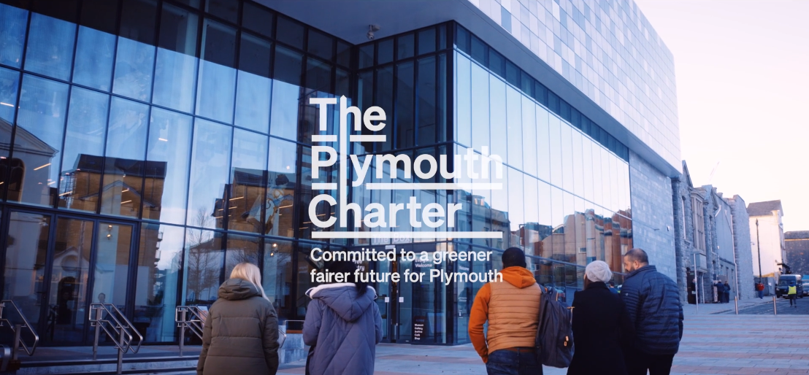
The Plymouth Charter – 30 Voices Campaign
30 Voices Trailer

Slide 5
3 intervention priorities
Sectors with more flexible jobs
Social mobility
Creating a more flexible economy
Notes:
Today’s political priorities are about digital and green jobs. How do we address these priorities in these sectors?

Slide 6
How are Plymouth addressing these priorities?
We are now part of the national inclusive growth network
14 councils and combined authorities leading the drive for inclusive local economies across the UK.
Notes:
Manchester is also prioritising flexible working
Plymouth Charter has an engagement strategy to work with local businesses
Challenge – there are businesses who do and are great but we are still hearing of companies that are not forthcoming in change

Slide 7
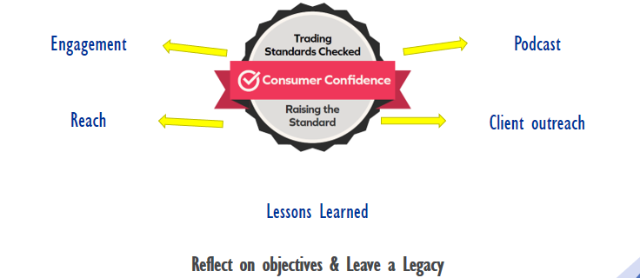
KCC - Challenges

Slide 8
Discussion
How do we encourage businesses to engage and take up changes?
Notes:
Today’s political priorities are about digital and green jobs. How do we address these priorities in these sectors?

Slide 9
Thank you!

