Slide 1
C-Care Project Closure Event
1 March 2023 - 1 Mars 2023
C-Care Évènement De Cloture du Projet

Slide 2
Welcome to the C-Care Project Closure Event
Derek Murphy,
Kent County Council Cabinet Member for Economic Development

Slide 3
Tackling common challenges
Finding shared solutions
Relever des défis communs
Trouver des solutions communes
Notes:
I am extremely pleased to be here today to mark this occasion.
Project closure is an opportunity to celebrate your projects achievements and outputs and the journey you have been on to get to this point.
For those that don’t know, the Interreg France (Channel) England programme was set up in 2014 to deliver economic, social and environmental growth in the south of the UK and the north of France.
Right at the beginning of this journey, we developed a cooperation agreement between the UK and FR delegation setting out the guiding principles and the common challenges – that would decide the specific objectives for the Programme.

Slide 4
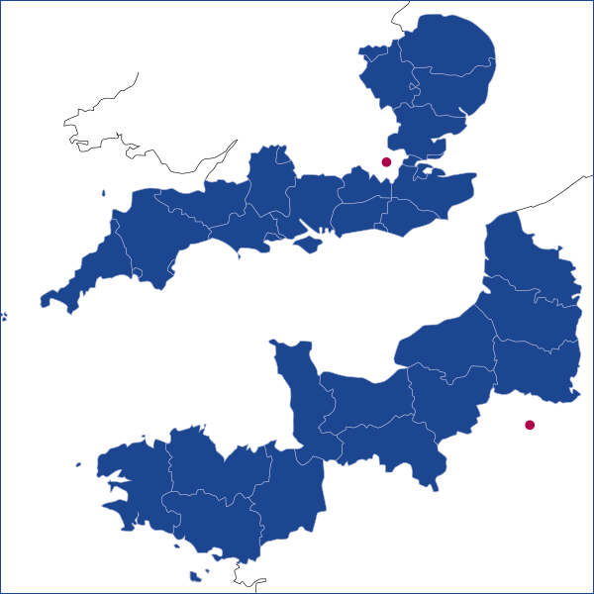
FCE Programme overview / Aperçu du programme FMA
Notes:
The Interreg FCE programme was funded by the European Regional Development Fund (ERDF), with the objective to correct imbalances between its regions, by supporting economic recovery, job creation, competitiveness, innovation, and sustainability.
Interreg has and continues to be a key instrument of the European Union to support cooperation between partners across borders to tackle common challenges together and find shared solutions – whether in the field of health, research and education, transport, or sustainable energy.
The FCE programme does this by bringing together partners in the UK and France, from the South and East Coasts of England from Cornwall to Norfolk, and the North Coast of France from Finistère to Pas-de-Calais.
Over the past 8 years the Programme and projects have successfully overcome a number of unexpected hurdles from Brexit to Covid-19.

Slide 5
High-quality projects with real world impact / Des projets de haute qualité avec un impact réel
€232m
Fund / fonds
125,284
sq. km
Region /
région
24.5m
Population
51
Projects
/ projets
420
Organisations
24.5m
population
Notes:
Pivoting around 3 priority axis and 5 specific objectives, the programme has committed 232.8 € million via the European Regional Development Fund to the funding of 51 projects -including 8 micro-projects- bringing together 420 project partners from across the Channel area.
C-Care is amongst the 51 projects helping to bring benefits to the FCE area which serves a population of approx. 24m and spans about 125,000 square kilometres.

Slide 6
Programme specific objectives / Objectifs spécifiques du programme
Innovation / Innovation
17 projects / projets
Social Innovation /
Innovation sociale
8 projects / projets
Low Carbon Technologies /
Technologies bas carbone
11 projects / projets
Coastal and Transitional
Water Ecosystems /
Écosystèmes côtiers et
des eaux de transition
10 projects / projets
Natural & Cultural Heritage /
Patrimoine naturel et culturel
5 projects / projets
Notes:
Of those 51 projects, we have funded 17 innovation projects, 8 social innovation, 11 promoting low carbon technology, 5 natural and cultural heritage projects and 10 enhancing and protecting coastal and transitional water ecosystems.

Slide 7
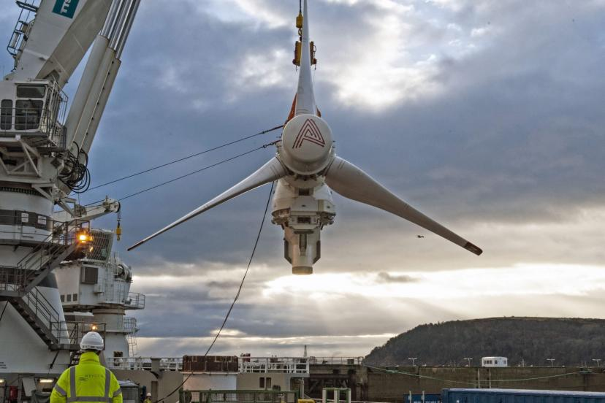
Project Examples / Exemples de projets
TIGER – Tidal Stream Industry Energiser Project
EXPERIENCE - Experiential Tourism to Extend the Visitor Season
Notes:
TIGER (Low Carbon Technologies)
€45.4m project, making it Interreg’s biggest ever project
The project accelerates development of & makes cost-effective case for tidal stream energy as part of a low carbon energy mix
Significant economic benefit for coastal communities
Installation of 15 turbines in the Channel area, with potential for total energy capacity of 8.8MW, which could reduce greenhouse gas emissions by 11K tonnes
EXPERIENCE (Natural & Cultural Heritage)
€24.5m project
Led by Norfolk County Council, EXPERIENCE sought to extend the tourism season
Tested and launched new off-season, experiential tourism offers for 20 million off-season visitors
Evaluating and improving sustainability within new off-season tourism offer in 6 pilot regions

Slide 8
Project Examples / Exemples de projets
INCREASE VS – Increase Valorisation Sociale
PACCO – Promoting Adaptation to Changing Coasts
REVERT – The Reversible Dementia Project
Notes:
INCREASE (Social Innovation)
€13m project
INCREASE has developed training schemes in order helping social housing residents start a micro-business or re-enter employment.
As of March 2022, the project has helped more than 2,300 people into jobs and start-ups
REVERT (Innovation)
€3.5m project
The project sought to address the fact that 5-15% of dementia patients (equivalent of about 65,000 - 200,000 people) are misdiagnosed with Alzheimer’s each year
These patients should in fact be treated for Normal pressure hydrocephalus (NPH) a treatable condition
REVERT has implemented innovative medical tools to diagnose NPH patients quickly and accurately as part of an integrated care pathway
PACCO (Coastal & Transitional Water Ecosystems)
€27.2m project
The project has restored 100 hectares of coastal wetland at two pilot sites – the Otter Estuary in Devon (UK) and Saane Valley in Normandy (France)
This will allow better management of flooding, absorb carbon, and provide benefits for people and wildlife.

Slide 9
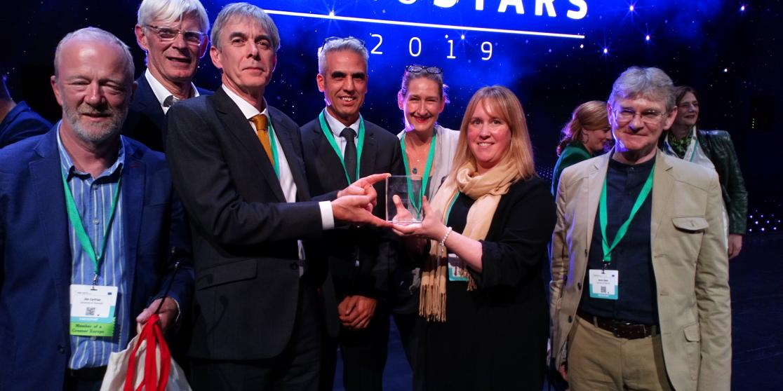
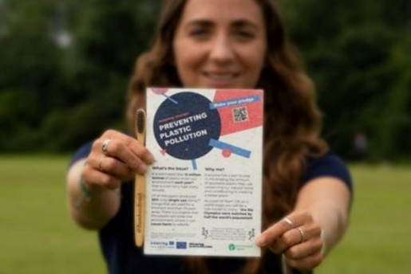
Our Programme highlights / Les temps forts de notre programme
Largest Interreg project / Le plus grand projet Interreg – TIGER
2 x Regiostars winners / gagnants – CobBauge (2020) & Coo-L Food (2019)
Presence at COP27 /présence à la COP27 – ReCon Soil
Promotion at the Tokyo Olympics / Promotion aux JO de Tokyo – PPP
Exposure on national TV, BBC Countryfile / Exposition à la télévision nationale – PACCo
Notes:
TIGER is biggest ever funded Interreg project.
In total our projects have been recognised with around 32 awards, and for 2 consecutive years an FCE project won a RegioStars award – CobBauge and Cool Food.
In November 2022, ReCon Soil & CobBauge exhibited at COP 27 and used it as opportunity to highlight the importance of protecting and reusing soil, as part of a delegation organised by University of Plymouth
Preventing Plastic Pollution was promoted at Tokyo Olympics in Summer 2021. A flyer produced on behalf of PPP was included in Team GB’s Olympic kit bags, encouraging British athletes to become plastic pollution prevention ambassadors. The initiative was the result of a collaboration between project Preventing Plastic Pollution, the Environment Agency and the Big Plastic pledge, founded by Olympic Champion in sailing and Team GB flagbearer Hannah Mills.
We’ve received lots of media coverage for our projects in French and UK media. In early 2022, PACCo project featured as part of BBC Country File’s visit to Clinton Devon Estates and the Lower Otter valley. While Aspire project featured on BBC News in 2022.

Slide 10
Your project highlights / Votre projet mis en avant
C-Care – Covid Channel Area Response Exchange
Common Indicator 45 - Number of participants promoting gender equality, equal opportunities and social inclusion across borders.
Businesses supported: 545
Supporting individuals at risk of unemployment: 863
Legacy
Toolkits developed for the changing nature of business.
Changing nature of our high streets.
Can be shared widely.
Notes:
Increase the quality and effectiveness of service delivery to the most socially and economically disadvantaged groups through social innovation
Four programme output indicators, concentrating on one today, as it is the most tangible to a wide audience. CI45
Also legacy is an important one for us.
Lessons learned from the impact of COVID and what can be done differently.
Toolkit to prepare for the next pandemic or event, a chance to be proactive and pivot sooner to new ways of working. Soften the economic impact.
AS the high streets have changed, not just because of COVID, but they ways in which we use them. More of a cultural hub than purely for shopping.
Dissemination of the lessons learned for other Interreg programmes and generally other economies.
*Outputs – worth including a highlight of actual spend and achievement of output indicators in relation to the programme targets to highlight how they are contributing to the programme.

Slide 11
Thank you and congratulations on your achievements / Merci et félicitations pour vos accomplissements
Notes:
Finally, we would like to say thank you to all the projects and project partners for all your hard work, enthusiasm, commitment and, of course, the many outstanding achievements

Slide 12
Overview of C-Care
Vue d’ensemble du projet C-Care
Covid Channel Area Response Exchange
Steve Samson & Guillaume Strebelle
Kent County Council

Slide 13
Developing C-Care
Le développement du projet C-Care
The pandemic impacted everything
Businesses were hit hard
Some sectors really suffered
Individuals struggled
Social Exclusion was exacerbated: digital poverty increased
The way we use our town centres changed
The future was uncertain
La pandémie a eu des répercussions pour tous
Les entreprises ont été durement touchées
Certains secteurs ont vraiment souffert
Individus en difficulté
L’exclusion sociale a été exacerbée : la précarité numérique a augmenté
La façon dont nous utilisons nos centres-villes a changé
L’avenir était incertain

Slide 14
About C-Care
À propos de C-Care
Projet Interreg « Capitalisation » soumis dans le cadre d’un appel à projets spécial : « Réponse d’urgence face au COVID-19 - Maximiser l’impact du projet ».
Chef de File: Kent County Council Objectif : Relever les défis socio-économiques causés par la pandémie de COVID-19 Budget total : 6,7 millions d’euros de Fonds Européen de Développement Régional Calendrier : avril 2021 – mars 2023
Interreg ‘Capitalisation’ Project submitted under special call for proposals: ‘Covid-19 emergency response - Maximising project impact’.
Lead Partner: Kent County Council
Aim: To respond to socio-economic challenges caused by the Covid-19 pandemic
Total budget: €6.7m European Regional Development Fund
Timescale: April 2021 – March 2023

Slide 15
Developing C-Care
Le développement du projet C-Care
The Interreg FCE Programme offered a chance to apply for funding
A partnership was formed during lockdown
Key topics were discussed
The focus was determined
A bid was developed, submitted, approved
We had to hit the ground running!
Brexit & the war in Ukraine caused even more challenges along the way!
Le programme Interreg FCE a présenté une opportunité de financement
Un partenariat a été formé pendant le confinement
Les principaux sujets ont été abordés
L’objectif a été déterminé
Une candidature a été élaborée, soumise et approuvée
On a dû se mettre immédiatement au travail !
Le brexit et la guerre en Ukraine ont causé encore plus de défis en cours de route!

Slide 16
Delivering C-Care
La mise en oeuvre du projet C-Care
But…
C-Care has had a huge impact on the ground
We’ve helped more than 1,700 businesses practically and in building resilience
We’ve supported more than 1,500 individuals with access to employment and business creation
We’ve put plans in place to boost town centres on both sides of the Channel
Mais…
C-Care a eu un impact prépondérant sur le terrain
Nous avons aidé plus de 1 700 entreprises sur le plan pratique, en renforçant leur résilience.
Nous avons aidé plus de 1 500 personnes à accéder à l’emploi et à la création d’entreprise.
Nous avons mis en place des programmes pour dynamiser les centres-villes des deux côtés de la Manche

Slide 17
Our Closure Event
Notre événement de clôture
Day 1:
Sharing success and lessons learned
Day 2:
Looking to the Future and next steps
Please interact as much as possible!
Jour 1 :
Partage des réussites et des leçons apprises
Jour 2 :
Regard vers l’avenir et les prochaines étapes
Veuillez interagir autant que possible!

Slide 18
C-Care Partner Organisations
Les Organisations Partenaires C-Care
Supported by an amazing network of stakeholders, service providers and friends of the project (Thank You!)
Soutenu par un réseau incroyable de parties prenantes, de prestataires et d’amis du projet (Merci!)

Slide 19
Overall Project Structure
Structure du Projet dans son Ensemble
Respond, Reflect, Report
C-Care Support for Social Inclusion
Support for Business Recovery
Reset & Redesign
1. Réagir, Réfléchir, Rendre Compte
2. C-Care Soutien à l’inclusion sociale
3. C-Care Soutien pour la reprise des entreprises
4. C-Care Réinitialiser et Redéfinir

Slide 20
C-Care Respond, Reflect, Report C-Care Réagir, Réfléchir, Rendre Compte
Regional Reviews:
Direct support and grants for businesses
Skills and employment support for individuals
The impact on our town centres and employment premises
Digital skills and infrastructure
Project Level Evaluation Work:
Collating Best Practice from France Channel England (FCE) region
Measuring the impacts of C-Care actions
Future recommendations
Evaluation report
Case studies
Connecting to other FCE projects
Analyses régionales :
Soutien direct et subventions aux entreprises
Soutien au niveau de l’emploi et des compétences pour les particuliers
L’impact sur les centres-villes et les locaux commerciaux
Compétences numériques et infrastructure
Travail d’évaluation au niveau du projet :
Etat des lieux des bonnes pratiques dans la région France- Manche – Angleterre (FCE)
Mesure des impacts des actions du projet C-Care
Futures Recommandations
Rapport d’ évaluation.
Études de cas
Liens avec d’autres projets dans la region FCE

Slide 21
C-Care for social inclusion C-Care pour l’insertion sociale
In Finistère:
Support for vulnerable self-employed people.
Tackling digital skills poverty.
Support in Norfolk and Suffolk to start a business.
Creating a community Hub in Plymouth.
Supporting apprenticeships in Norfolk.
Training for the hospitality sector – Pas-de-Calais.
Dans le Finistère:
Soutien pour les travailleurs indépendants vulnérables.
Lutte contre la précarité numérique.
Soutien dans le Norfolk et le Suffolk à la création d'entreprise.
Création d'un centre communautaire à Plymouth.
Soutien à l'apprentissage dans le Norfolk.
Formations pour le secteur de l’hôtellerie-restauration – Pas-de-Calais.

Slide 22
C-Care – Business Support C-Care – Soutien aux Entreprises
1. Green recovery voucher scheme in Kent.
2. Voucher schemes in Kent and Norfolk to enable small businesses to enhance their digital capabilities.
3. A Covid-secure accredited training module for the home improvement and maintenance sector in Kent
4. Programme for inclusive economic growth in Plymouth.
5. New business models for a strong Future (CESI)
1. Programme de "bons verts" dans le Kent.
2. Programmes de bons numériques dans le Kent et le Norfolk afin de permettre aux petites entreprises d’améliorer leurs compétences numériques.
3. Module de formation accréditée sur la covid-19 dans le Kent (notamment pour les entreprises intervenant à domicile).
4. Programme pour une croissance économique inclusive à Plymouth.
5. Un nouveau modèle d'entreprise pour l'avenir.

Slide 23
C-Care - Reset and redesign C-Care – Repartir sur de bonnes bases
Feasibility studies as blueprints for market town services of the future. (NALEP)
Blueprints to plan for future business, community activity and culture in town centre. (PCC)
New business modelling to test with French and English companies & toolkit for resilient businesses. (CESI)
A promotional campaign to boost the hospitality and leisure sector in Pas-de-Calais.
Business Resilience Toolkit
Sustainable Business Toolkit
Études de faisabilité comme plans sur le centre-ville de demain. (NALEP)
Plans pour planifier les activités culturelles, commerciales et citoyennes futures des centres-villes. (PCC)
Expérimentation d'un nouveau modèle d'entreprise auprès d’entreprises françaises et anglaises. (CESI)
Campagne promotionnelle pour dynamiser le secteur de l’hôtellerie et des loisirs dans le Pas-de-Calais.
Panoplie d’outils résilients pour les entreprises.
Panoplie d’outils durables pour les entreprises.

Slide 24
Thank you for joining us today!
Take care,
The C-Care Team.

Slide 25
C-Care
(Covid Channel Area Response Exchange)
Closure Event
1 March 2023
Breakout Sessions

Slide 26
Interreg C-Care Project Closing Event – Canterbury, Kent
1-2 March 2023 What makes a resilient Business?

Slide 27
Agenda
Organizational resilience
The case of the Covid-19 crisis
Resilience factors
Innovation capacity
Collaboration
Process
Agility
Organisation
Stratégy

Slide 28
Organizational resilience: definition
Resilience :
Ability of a company to cope with the disruption of its usual activities generated by a shock, while continuing to operate efficiently (Thukral, 2021).
Types of shocks:
The consequences of an economic or social crisis
The sudden obsolescence of a technology
A frontal attack from a competitor
A tragic technical accident
A damage to reputation
Notes:
Nous vivons une période sans précédent de perturbations économiques, sociales et sanitaires, et la pandémie COVID-19 en est un excellent exemple puisqu’elle a changé notre façon de vivre, de travailler et d’interagir les uns avec les autres.
La majorité des entreprises ont été touchées de manière significative et ont dû faire face à des défis sans précédent. Dans ce contexte difficile, la résilience est devenue un enjeu crucial pour les entreprises et ceux quelque soit leur taille. Les entreprises résilientes sont mieux préparées à gérer les risques et les incertitudes, et en s'adaptant rapidement à des conditions changeantes, elles sont plus susceptibles de survivre et de prospérer dans des situations difficiles.
La résilience est la capacité […]. Les chocs ou les perturbations peuvent avoir des natures divers, ça peut être[…]

Slide 29
Organizational resilience: a continuum
Retranchement
Perseverance
Innovation
Medium term
Commitment to strategic renewal
Long term
Maintenance of the company's level of activity
Short term
Cost-cutting measures that may reduce the scope of a company's
(Wenzel et al., 2020)
Notes:
Des études précédentes ont démontré qu’il ne s’agissait pas d’un état mais d’un processus constitué de 3 stratégies dans un but d’innovation de business model :
Retranchement : la PME met en place des mesures rapides à court terme ne nécessitant pas de changement organisationnels important qui sont cependant susceptible de réduire l’étendue des activités tels que la réduction des coûts.
Persévérance : la PME met en place des mesures de protection à moyen terme tels que l’extension des canaux de distributions ou la mobilisation des ressources sous-exploitées pour ramener son niveau d’activité à la normale le plus rapidement possible.
Innovation : la PME s’engage dans un renouvellement stratégique de son business model tel que l’élargissement à de nouveaux marchés, l’intégration de nouvelles compétences/technologies ou la proposition de nouveaux produits/services.

Slide 30
The case of the Covid-19 crisis: disturbances generated
Forced closure of the company
Containment measures
Containment measures
Purchase of protective equipment, implementation of health protocols and telecommuting
Lost of revenue
Financial difficulties
Difficulty paying debts due to loss of revenue and increased costs
Increased costs
Reduction in international trade Supply chain disruptions resulting in delivery delays and shortages
Decreased productivity Change and decline in customer demand
Loss of jobs
Notes:
La pandémie COVID-19 a mis en lumière l'importance de la résilience pour les entreprises. Elle a entraîné une crise économique sans précédent, avec les fermetures forcées des entreprises […]

Slide 31
The case of the Covid-19 crisis: types of Business Models (BM) observed
Robust BM
Antifragile BM
Activity performs better during crisis. Some capabilities considered expensive, complex, and unproductive before the crisis became important after the crisis. Need to have the right environment to accelerate business development.
Activity at a desired operational state during the crisis. Areas in which the crisis has changed only the volume and not the nature of the business. Need to manage to ensure business continuity and manage volume changes
Adaptative BM
Activity that has evolved to meet new needs. Costly and intense adaptation. Requires identifying development opportunities and implementing them quickly.
Retired BM
Temporary closure of the business with the intention to reopen after the crisis. The business will be profitable again after the crisis. Requires sufficient capital for the period of closure and guaranteed access to human resources upon restart.
Aided BM
The activity is not self-financing and needs external support such as a government aid program. The assistance provided is preferable to other alternatives (unemployment, loss of income, closure...) Need to identify and apply for assistance to resume business at a later date.
Suspended BM
Temporary closure of the business with the intention to reopen after the crisis. The business will be profitable again after the crisis. Requires sufficient capital for the period of closure and guaranteed access to human resources upon restart.
(Ritter et Lund Pedersen, 2020)
Notes:
Plusieurs situations ont été observées face à ces perturbations et 6 types de BM ont ainsi été identifiés.

Slide 32
The case of the Covid-19 crisis: responses from more resilient SMEs
Cost reduction
Reorganization of activities
Reconfiguration of the supply chain
Expanding distribution channels
Adaptation of the existing value proposition
Development of a new value proposition
Development of a new business model
Notes:
Pour s'adapter rapidement à ces perturbations et tenter de maintenir leur activité malgré les défis auxquels elles sont confrontées, les PME les plus résilientes ont développé un large éventails de solutions que l’on peut regrouper en différentes catégories :
Réduction des coûts : ce type de mesure tel que la mise en place du chômage partiel conduit généralement à une réduction du périmètre d'activité de l'entreprise, voire à une suspension de son activité pendant la crise
Réorganisation des activités : adaptation des routines organisationnelles en intégrant le numérique, exploitation des compétences et infrastructures disponibles afin de trouver des solutions extrêmement rapides dans une perspective de court terme.
Reconfiguration de chaîne de valeur : extension, réduction ou abandon de partenariat avec des fournisseurs ou prestataires dans le but d’assurer un approvisionnement
Extension : Développer de nouveaux canaux de distribution pour atteindre le client, généralement en incluant des outils numériques : vente en ligne, livraison à domicile
Adaptation de la proposition de valeur : Reformuler la proposition de valeur pour s’adapter aux besoins changeant des utilisateurs (les compétences et ressources restent les mêmes)
Développement d’une nouvelle PV : Se positionner sur un nouveau marché en proposant une nouvelle offre (les compétences et ressources restent les mêmes mais nouveaux clients)
Nouveau BM : Développer de nouvelles activités en s'appuyant sur de nouvelles ressources et compétences ou par le biais de nouveaux partenariats.

Slide 33
Resilience factors
Innovation capacity
Collaboration
Process
Agility
Organisation
Strategy
Notes:
Au travers les différentes solutions apportées, il nous a été possible d’identifier 6 facteurs de résilience pour un business model

Slide 34
Resilience factors
Innovation capacity
Collaboration
Process
Agility
Organisation
Strategy
Explanation:
Develop and implement new or improved products, services, and business models to support adaptation to market disruptions. SMEs that are able to innovate quickly to meet market needs are more likely to succeed in the long run.
Indicators:
Innovation practices
The firm is able to innovate quickly to meet changing market needs
Technology and knowledge
The company effectively uses digital technologies to communicate, sell online or collaborate remotely
Customer satisfaction
The company has a deep understanding of customer/user needs or market trends, and responds quickly to their changes

Slide 35
Resilience factors
Innovation capacity
Collaboration
Process
Agility
Organisation
Strategy
Explanation:
Collaboration to better adapt to change: partners can help find new revenue streams, access new markets, reduce costs, and share risks.
Indicators:
Partners
The company is able to collaborate with partners to access new markets or adapt more quickly to change.
Internal collaboration
Collaboration to better adapt to change: partners can help find new revenue streams, access new markets, reduce costs, and share risks.

Slide 36
Resilience factors
Innovation capacity
Collaboration
Process
Agility
Organisation
Strategy
Explanation:
A diversified supply chain reduces dependency on a single supplier, subcontractor or contractor, limiting disruption or downtime.
Indicators:
Chaîne d'approvisionnement
The company has a diversified and flexible supply chain, which allows it to adapt quickly to disruptions
Production
The company has robust and flexible production processes. Contingency plans are in place in case of major problems and are regularly tested.

Slide 37
Resilience factors
Innovation capacity
Collaboration
Process
Agility
Organisation
Strategy
Explanation:
A flexible organizational structure that can adapt quickly to changes in the market and environment is better prepared for uncertainty.
Indicators:
Leadership
he company has clear and adaptive decision-making processes that allow it to respond quickly and effectively to change.
Intelligence
he company has clear and adaptive decision-making processes that allow it to respond quickly and effectively to change.

Slide 38
Resilience factors
Innovation capacity
Collaboration
Process
Agility
Organisation
Strategy
Explanation:
Fostering communication and training for employees facilitates adaptation to change and promotes flexibility.
Indicators:
Human ressources
The company has a strong corporate culture that encourages employee engagement, collaboration and retention.
Organizational routines
Organizational routines are flexible and can be easily adapted to unexpected situations. Employees are encouraged to offer ideas for improvement.

Slide 39
Resilience factors
Innovation capacity
Collaboration
Process
Agility
Organisation
Strategy
Explanation:
Fostering communication and training for employees facilitates adaptation to change and promotes flexibility.
Indicators:
Human ressources
The company has a strong corporate culture that encourages employee engagement, collaboration and retention.
Organizational routines
Organizational routines are flexible and can be easily adapted to unexpected situations. Employees are encouraged to offer ideas for improvement.

Slide 40
Level of resilience
Strong resilience
Highly adaptable, allowing us to react quickly to market changes and find new business opportunities.
Moderate resilience
Able to cope with temporary market disruptions, but may have difficulty adapting to more drastic changes. Need to develop a more proactive strategy to further build resilience.
Low resilience
Little flexibility and difficulty adapting to market changes. Strategic shift to improve long-term resilience should be considered.
Variable resilience
May face situations where resilience is higher in some areas and lower in others. For example, the SME may have high organizational flexibility but excessive dependence on a single supplier or customer. This profile requires a more detailed assessment of resilience factors to identify areas for improvement.
Critical resilience
Vulnerability to disruption: possible dependence on a single source of revenue, low innovation capacity, low flexibility, or weak partnerships. Significant efforts must be made to build resilience or risk jeopardizing the survival of the SME.
Notes:
On peut donc identifier plusieurs niveaux de résilience en fonction

Slide 41
Conclusion
Resilience is a major issue for SMEs:
Adaptation to changes in the environment
Adaptation to changes in customer needs
Importance of preparing upstream:
Need to integrate resilience factors into the company's strategy
Allows to face future challenges linked to the current economic, social and environmental environment in constant evolution.
Notes:
La résilience organisationnelle est un enjeu majeur pour les PME, en particulier dans des situations de crise telles que la pandémie COVID-19.
Les PME qui ont su faire preuve de résilience ont été celles qui ont faire preuve d’une capacité d’adaptation en répondant rapidement aux changements de l'environnement ou aux changements des besoins clients.
La résilience organisationnelle étant un processus continu et non un état, il est crucial de ce préparer en amont à des situations de crise en développant les différents leviers à savoir la capacité d'innovation, la collaboration, les processus, l'agilité, l'organisation et la stratégie.
Les dirigeants d'entreprise doivent donc comprendre ces facteurs de résilience et de les intégrer à leur stratégie. En investissant dans ces leviers, les PME seront en mesure de mieux se préparer à faire face aux futurs défis et à maintenir leur activité dans un environnement économique, social et environnemental en constante évolution.

Slide 42
Thank you!
Elodie PILLON
epillon@cesi.fr

Slide 43
The value of enterprise support

Slide 44
What are we dealing with..?
Global factors - Covid, War in Ukraine, cost of living crisis
UK-wide factors - Brexit, inflation and cost of doing business, changes in government policy
Local factors - Each locality also has its own place-based challenges and opportunities
… all these factors impact entrepreneurs, micro and small businesses as well as larger businesses… so why is enterprise support so essential and what does it achieve?
The Home of Enterprise Support
Notes:
Moving away from the pandemic
Financial support over the last few years has helped many small businesses survive. However, there is argument to be made that it has created some inefficiency among SMEs.
Measures now need to ensure that support encourages innovative start-ups and help processes of ‘creative destruction’ that can also contribute to more resilient entrepreneurial ecosystems and reduce the number of ‘zombie businesses’.
Current economic pressures
Interest rate rises along with the onset of a recession will make it harder for businesses to access loans and finance as banks tighten their eligibility requirements and increase the cost of such lending. Additionally, venture capitalists may become reticent to back many businesses given the forecast growth figures for the economy.
Inflation will have a major impact on businesses with ‘menu costs’ and higher energy costs affecting smaller businesses more as they do not have the economies of scale to match larger companies. Energy intensive production may become unprofitable and pricing for orders with prolonged lead times may become vulnerable to the instability in these prices.
Supply chain issues will have a much greater impact on smaller companies as they have less leverage than larger firms as they are ordering fewer units. This may result in a much longer time span between the product’s conception and it going to market, possibly reducing their competitiveness.

Slide 45
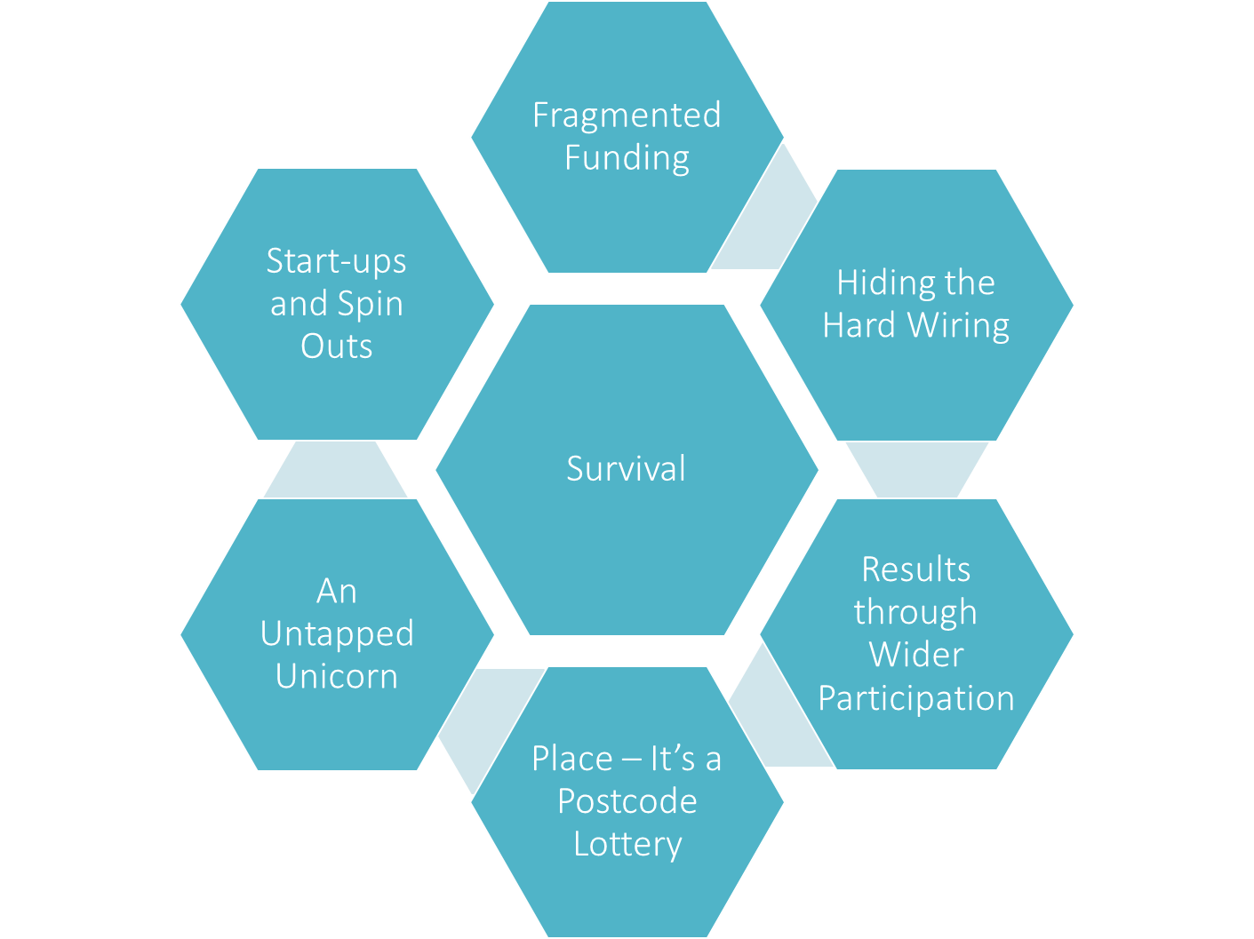
Themes From Our Findings…
The Home of Enterprise Support

Slide 46
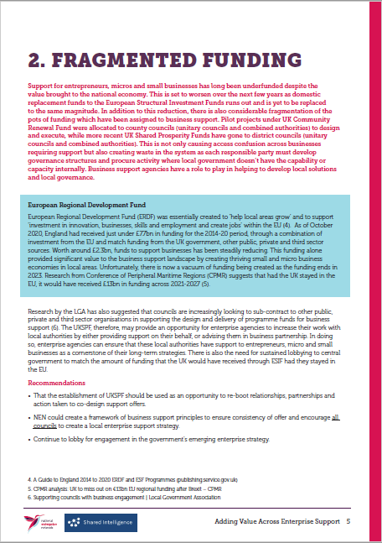
Research suggests that had the UK stayed in the EU, it would have received 13bn in ERDF across 2021-2027
The domestic replacement level including UK Community Renewal Fund and UK Shared Prosperity Fund does not match this level of funding
Recent reports from the Local Government Association suggest that councils are increasingly looking to sub-contract business support to public, private and third sector organisations. What is the reality..?
The Home of Enterprise Support
Notes:
In considering this question, we reviewed literature, spoke to key people and set out a series of headlines
- key literature which explores the different types of support, whether that be for access to finance, early-stage businesses or across different communities.
- identify the barriers faced by people wanting to establish their own business and the barriers they face in sustaining and growing that business.
- explore international examples of where governments have low barriers to entry and high value enterprise support.
Produce a research document which:
- succinctly demonstrates the value of support (financial, skills, social value)
- gives recommendations to improve the support further and reduce current barriers
- provides lobbying messages to central government about the importance of this area.
We have conducted the vast majority of our literature on enterprise support across a range of topics. Some literature includes:
- Research to understand the barriers to take up and use of business support
- Support for Small Businesses - House of Commons Library
- Business time - How ready are UK firms for the decisive decade?
- TIME TO CHANGE: A BLUEPRINT FOR ADVANCING THE UK’S ETHNIC MINORITY BUSINESSES

Slide 47
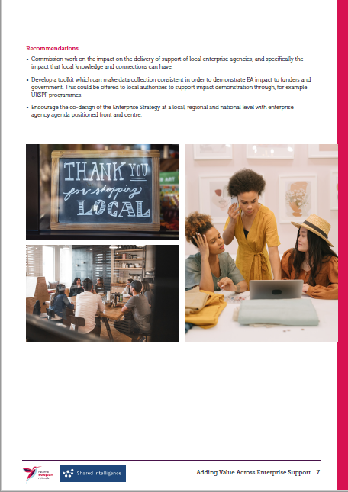
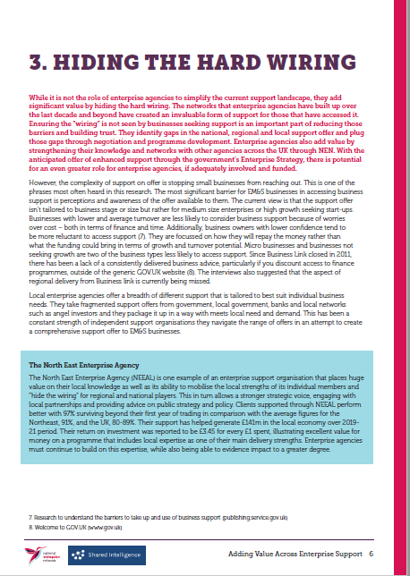
The most significant barrier for EM&S businesses in accessing business support is perceptions and awareness of the offer available to them
Much of the strength of local enterprise agencies current work involves taking fragmented support offers from stakeholders (including government, local government, banks and local networks) and packaging it in a way which meets local need and demand
The Home of Enterprise Support
Notes:
In considering this question, we reviewed literature, spoke to key people and set out a series of headlines
- key literature which explores the different types of support, whether that be for access to finance, early-stage businesses or across different communities.
- identify the barriers faced by people wanting to establish their own business and the barriers they face in sustaining and growing that business.
- explore international examples of where governments have low barriers to entry and high value enterprise support.
Produce a research document which:
- succinctly demonstrates the value of support (financial, skills, social value)
- gives recommendations to improve the support further and reduce current barriers
- provides lobbying messages to central government about the importance of this area.
We have conducted the vast majority of our literature on enterprise support across a range of topics. Some literature includes:
- Research to understand the barriers to take up and use of business support
- Support for Small Businesses - House of Commons Library
- Business time - How ready are UK firms for the decisive decade?
- TIME TO CHANGE: A BLUEPRINT FOR ADVANCING THE UK’S ETHNIC MINORITY BUSINESSES

Slide 48
Universities are set to provide £11.6bn in support over the next 5 years, however, some SMEs may be intimidated by universities
Enterprise agencies are well places to encourage entrepreneurs to go forward for support
The offer from enterprise agencies is creative at its core. Programmes such as “Prison Entrepreneurships Pilot” show that there is value to be added to the economy (17x ROI) from all types of support
The local place knowledge that enterprise agencies bring to the support agenda is under-valued but is instrumental in supporting entrepreneurs to start, survive and grow
Not all places prioritise business support, and therefore investment in core infrastructure can be limited – enterprise agencies bring social and economic value through their networks and assets
A robust national enterprise strategy with consistent investment and delivery of business support would improve levelling up across the country
The Home of Enterprise Support

Slide 49
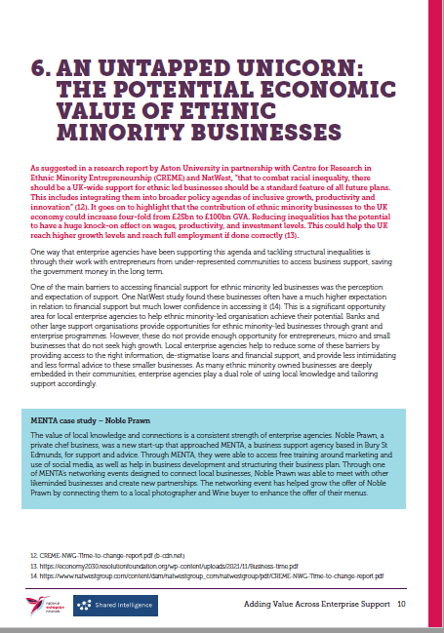
The contribution of ethnic minority businesses to the UK economy could increase four-fold from £25bn to £100bn
NatWest study found these businesses often have a much higher expectation in relation to financial support but much lower confidence in accessing it
Local enterprise agencies champion inclusivity and help to reduce some of the barriers by providing access to the right information and provide less intimidating and less formal advice to these smaller businesses
The Home of Enterprise Support

Slide 50
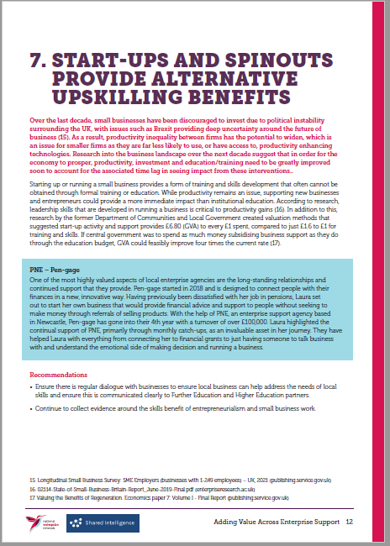
According to research, leadership skills that are developed in running a business is critical to productivity gains
Research by the former Department of Communities and Local Government created valuation methods that suggested start-up activity and support provides £6.80 (GVA) to every £1 spent, compared to just £1.6 to £1 for training and skills
The Home of Enterprise Support

Slide 51
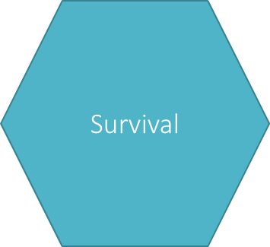
The model of early intervention is key to business survival, yet research suggests that businesses only tend to access enterprise support when confidence is higher than average or at times when businesses are struggling
The current lack of uptake of support means that the overall offer is not well enough promoted, not understood or limited in its delivery. This means small businesses are not developing to their full potential
What happens without support…?
NEN members have delivered an average of 585,549 square feet (1,100 business units) to businesses to occupy every year. Without this, it would leave small businesses trying to find the equivalent amount of workspace in an already crowded and overpriced market
Leaving support to the private sector would mean engagement would be delivered for more commercial gain and would not deliver the types of support, such as soft loans (as provided through the British Business Bank), grants, and free advice that underpins the survival of start-ups, and micro and small businesses
The Home of Enterprise Support

Slide 52
What Next..?
We have created some recommendations that would improve the offer of EM&S support and demonstrate the impact of it. They include:
To continue to work closely with government to ensure the delivery of the Enterprise Strategy at a local, regional and national level with enterprise agency agenda positioned front and centre.
To lobby government to re-appoint a dedicated Small Business Minister, with direct Cabinet responsibility and a mandate to ensure that the nation’s small businesses continue to be the envy of the world.
To develop a single sharing platform which documents best practice and collates learning materials on “what works”.
To develop a toolkit which can make data collection consistent in order to demonstrate EA impact to funders and government.
To develop a barometer or confidence index to understand the continually emerging issues faced by entrepreneurs, micros and small businesses.
The Home of Enterprise Support

