Slide 1
Interreg C-Care Project Closing Event – Canterbury, Kent
1-2 March 2023 Boosting Business Recovery:
Building Consumer Confidence with Kent County Council
Inclusive Growth with Plymouth City Council

Slide 2
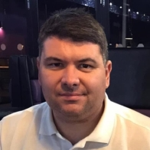
Introductions
Adam Mortimer
Scheme manager, Trading Standards, Kent County Council
Building Consumer Confidence
Ellie Tighe
Senior Economic Development Officer, Plymouth City Council
Inclusive Growth

Slide 3
Building Consumer Confidence
Trading Standards Checked

Slide 4
Building Consumer Confidence
Notes:
TS Checked is KCC’s fair trader scheme for home improvement traders. Established in early 2020, it provides the residents of Kent with a safe, reliable list of companies that they can be confident to welcome into their home to complete work. These companies are vetted to the highest standard by Trading Standards professionals. Please see why it is so important for our residents to be confident when inviting people into their homes.
(Play Mr Mercer Video)

Slide 5
Building Consumer Confidence
Insert Mr Mercer Video Here

Slide 6
Building Consumer Confidence
Outputs
500 traders participating in ‘covid-secure’ training
Initial thoughts
With Covid-19 restrictions lifted (at the time) was there still a need for training?
Did Kent businesses want training at all, and if so in what format?
We need to understand if certain demographics lack the confidence to have work done in their homes, whether this be essential or planned maintenance.
Did residents have any minimum expectations of tradespeople relating to COVID-19 safety?
Notes:
The TS Checked scheme was seen as a brilliant conduit to deliver training to over 250 members businesses in Kent on how to improve customer confidence in the wake of the Covid-19 pandemic. What we didn’t know to start with was the extent of the problem.
Thoughts
Next 3 slides are residents responses to the questions we asked them

Slide 7
Perceptions of allowing tradespeople into homes
Just over six in ten indicated they would be happy to let tradespeople into their home for improvements and/or repairs.
The proportion comfortable is highest amongst male residents and residents aged 75 & over. Perceived comfort is lowest amongst residents aged 16-34.
Which of the following best describes how you feel about letting tradespeople into your home now coronavirus restrictions have been lifted?
% I would be happy to let tradespeople into the home for improvements and/or repairs
Significantly higher % than other gender / age groups at 95% confidence level
Base: all answering (1,075)

Slide 8
Preferred precautions for tradespeople
Just over half (52%) would prefer tradespeople to wear face masks and other essential PPE when entering their home for improvements or repairs. Just under a third (31%) would like tradespeople to conduct a cleaning down regime..
If you needed a tradesperson to come into the home for improvements or repairs, which, if any, of the following precautions would you like them to take?
Base: all answering (1,075)

Slide 9
Likelihood of choosing a Covid-19 accredited company
Just under half (48%) indicated they would be more likely to choose a company with a Covid-19 accreditation; 30% indicated it doesn’t not matter either way.
There are no significant differences in perceived influence by gender or age.
Do you think you would you be more likely to choose a company with an accredited mark to show they are Covid-19 safe over a trader who doesn’t have this accreditation?
% Yes
Base: all answering (1,075)
Notes:
Now lets look at our businesses

Slide 10
Attitudes towards Covid-19 free training
Just under half agree (45%) completing Covid-19 safe training would offer their customers additional assurance.
Just under four in ten agree (38%) they would be interested in attending the training. The majority of these agreed they would like an additional free badge / accreditation for completing and would prefer online course / e-learning.
The Trading Standards Checked scheme is looking to arrange free training for Covid-19 safe working practices. The training would provide an additional badge or accreditation to add to your business profiles at no extra cost to you. How much do you agree or disagree with the following statements about such training....?
Interest in additional free badge or accreditation to add to profile for completing
45%
38%
38%
Formats would like to see training in:
Online course / e-learning – 70%
Online tutorials – 41%
Face to face course or seminar – 32%
Virtual webinars – 25%
27%
Base: all answering (116)

Slide 11
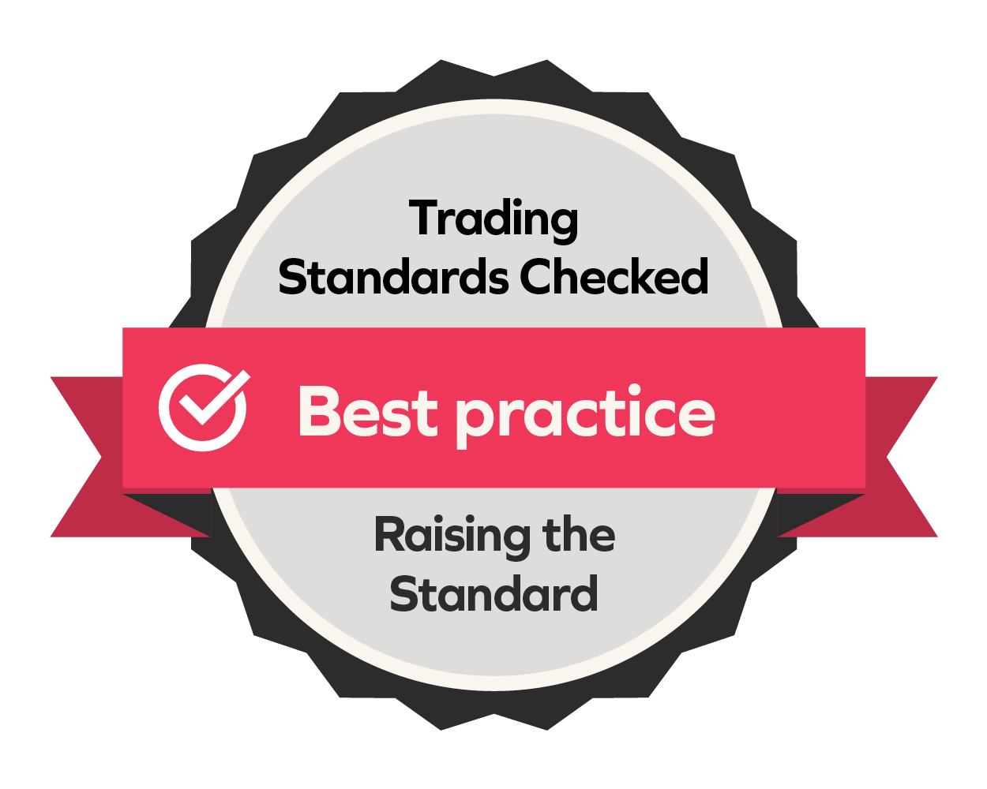
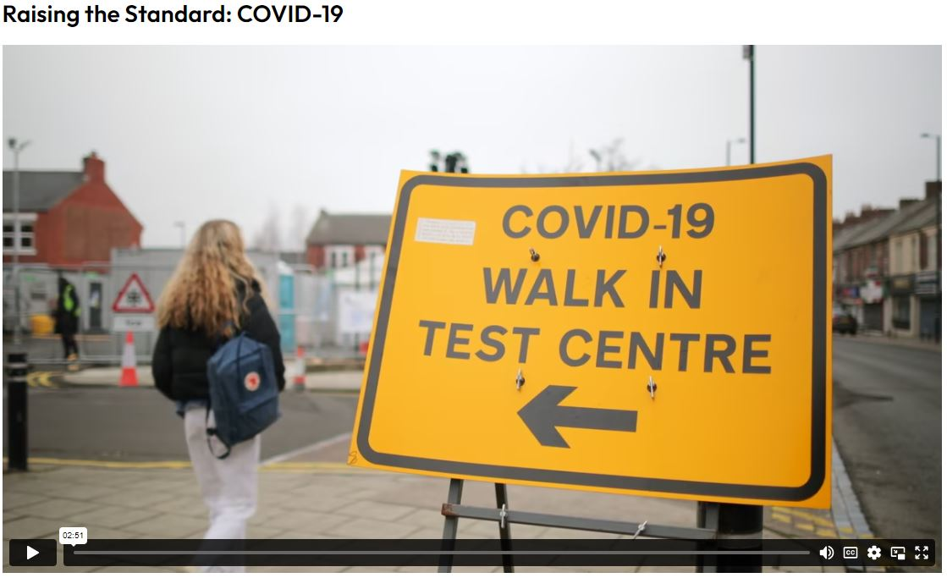
Building Consumer Confidence
Business support package
Raising the Standard Microsite
5 x podcasts
4 x short videos
4 x information booklets
4 x factsheets
4 x checklists
4 x e-Learning modules
Notes:
Translation of materials relevant for the French market into French language and hosted for 1 year
Legacy of the project for many years with resources that will stand the test of time as best practice documents

Slide 12
Podcasts
Pods listens
643
And counting….
Listen to this podcast in full and our other episodes at www.keepkentsafe.co.uk/podcasts
or on any reputable podcast platform by searching for
Raising the standard: Traders for a safer Kent

Slide 13
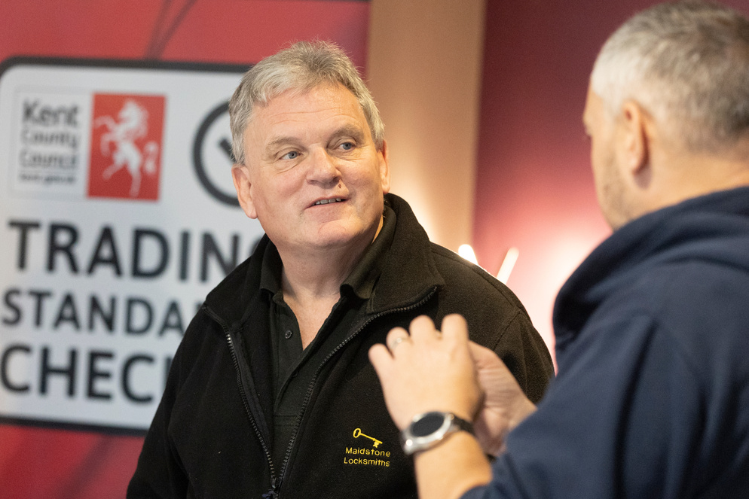
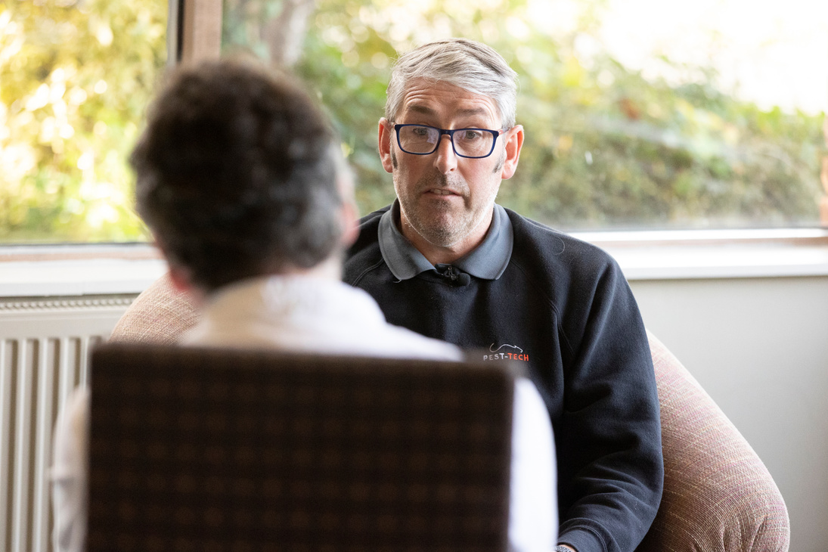
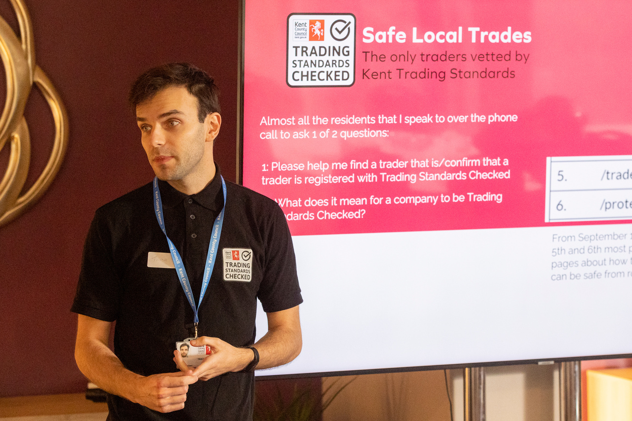
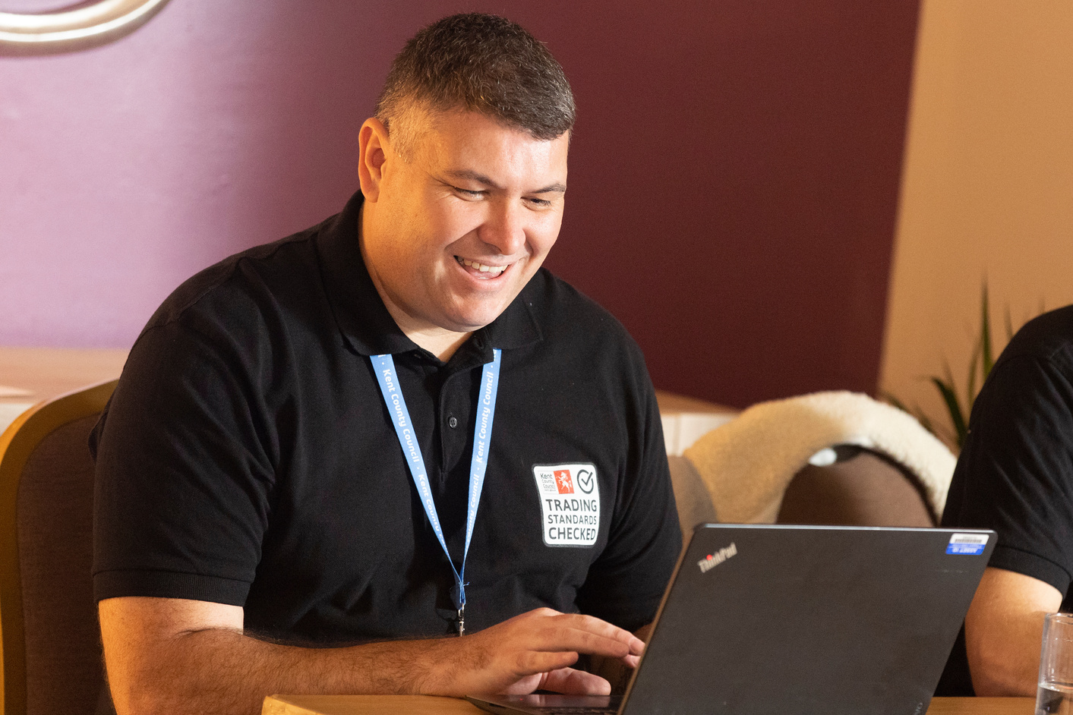
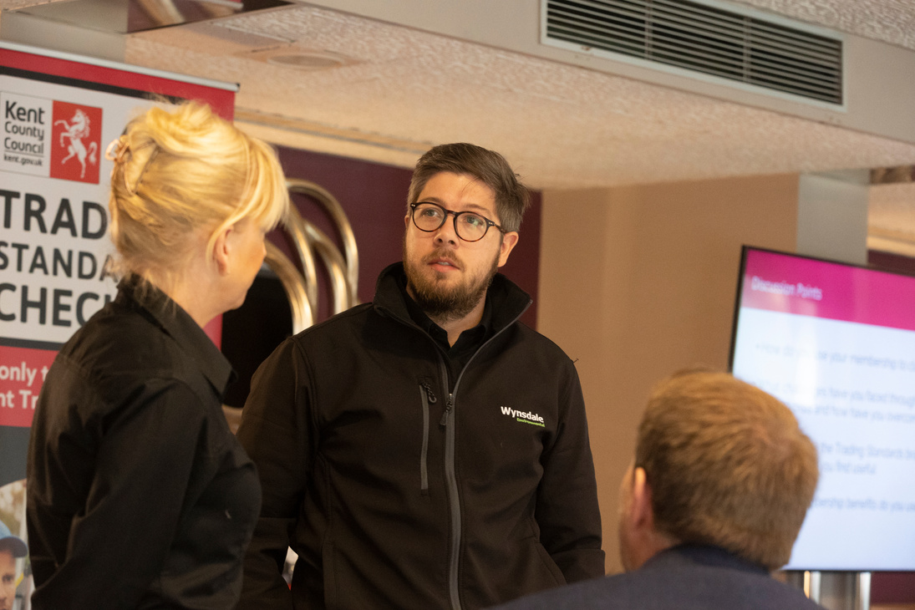
Networking Events

Slide 14
Resident Radio Ad Campaigns
ADS REACHED
300
THOUSAND

Slide 15
Net Magazine
Advertising the scheme and doorstep crime alerts to warn residents.
REACHED
2.86
MILLION
Trader directory with contact details for residents to use. Sent every 3 months.

Slide 16
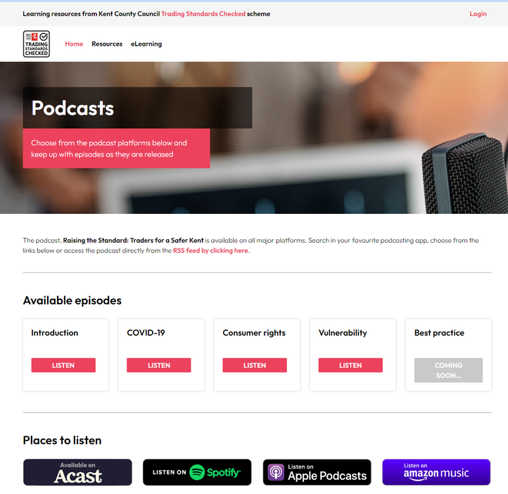
Trader business support campaign
5000 site visits
1800 Emails sent
74,000 social media reach

Slide 17
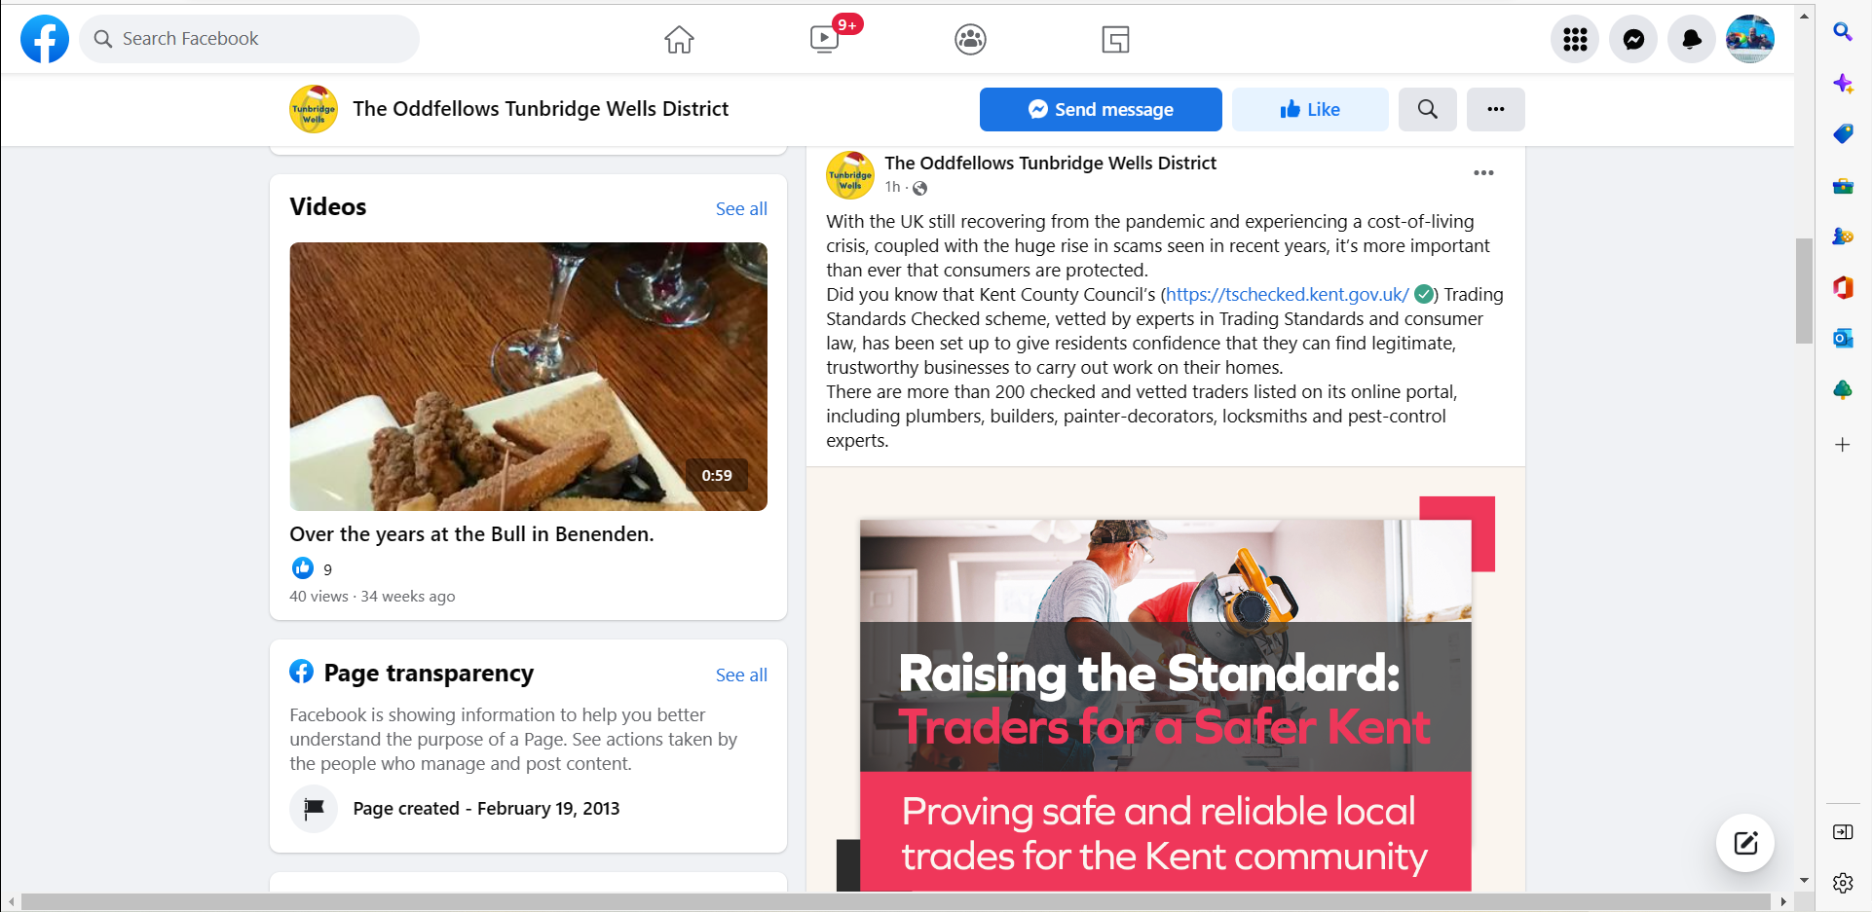
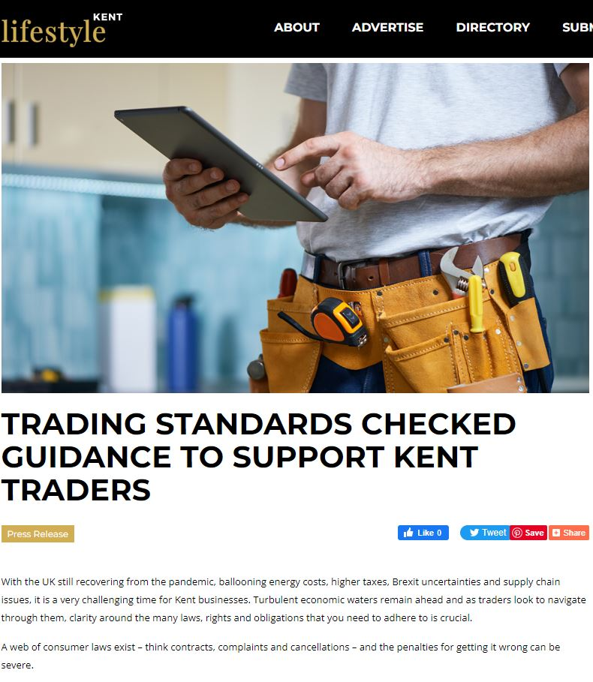
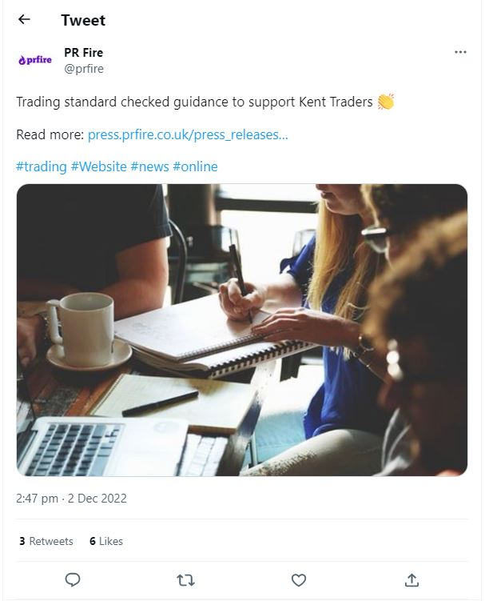
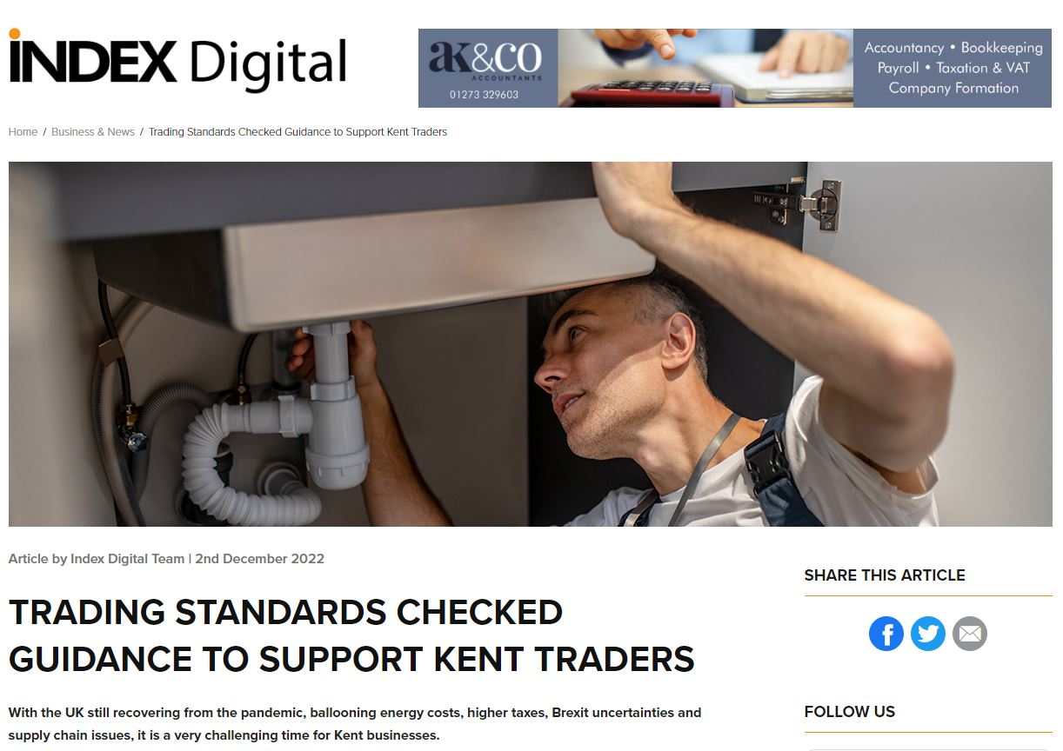
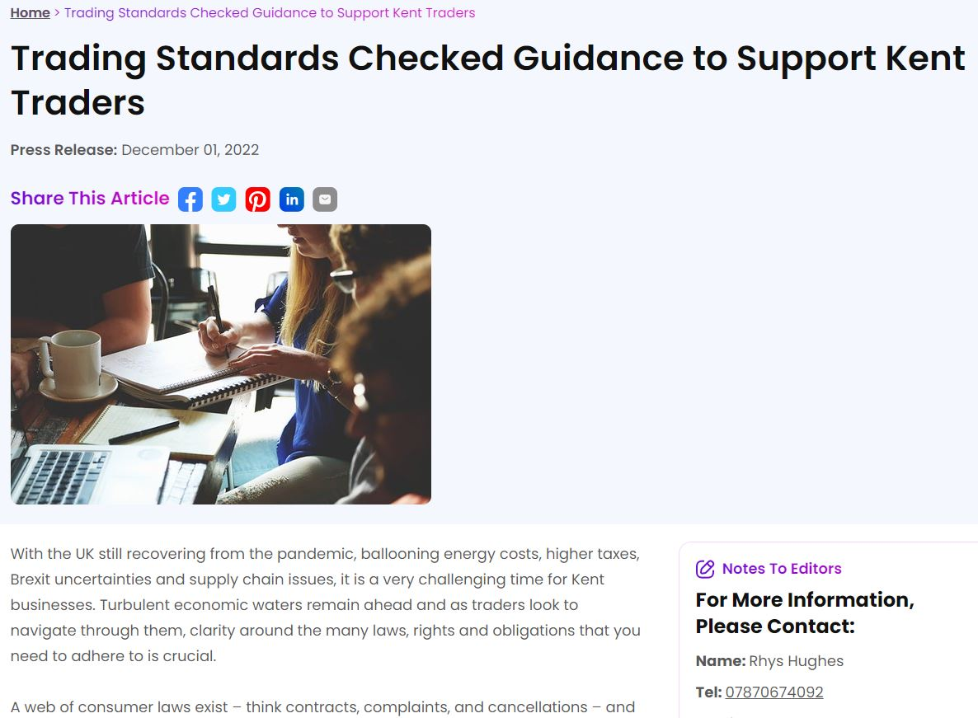
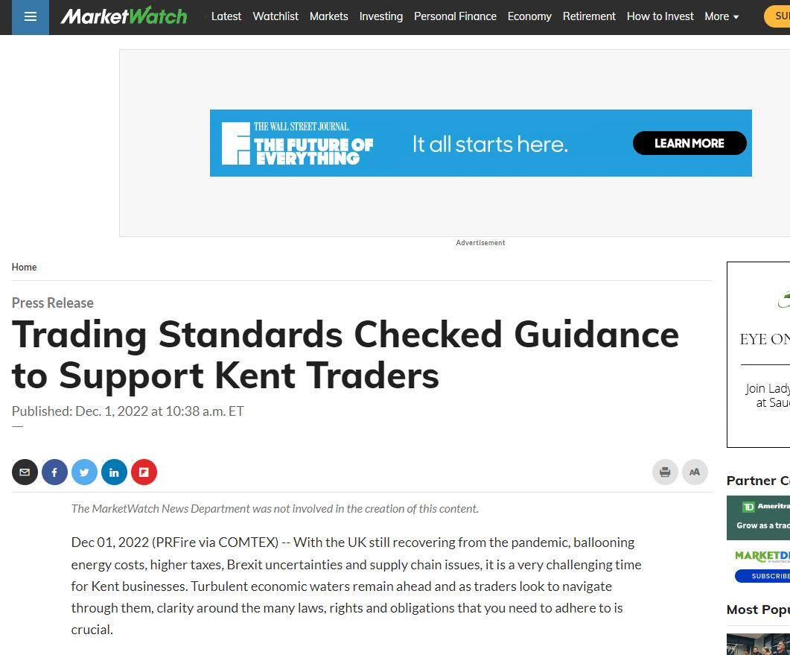
PR – Business Outreach
Advertising the business support package to local outlets and business journalists.
Press releases with further Linked in and social posts to similar business audiences.

Slide 18
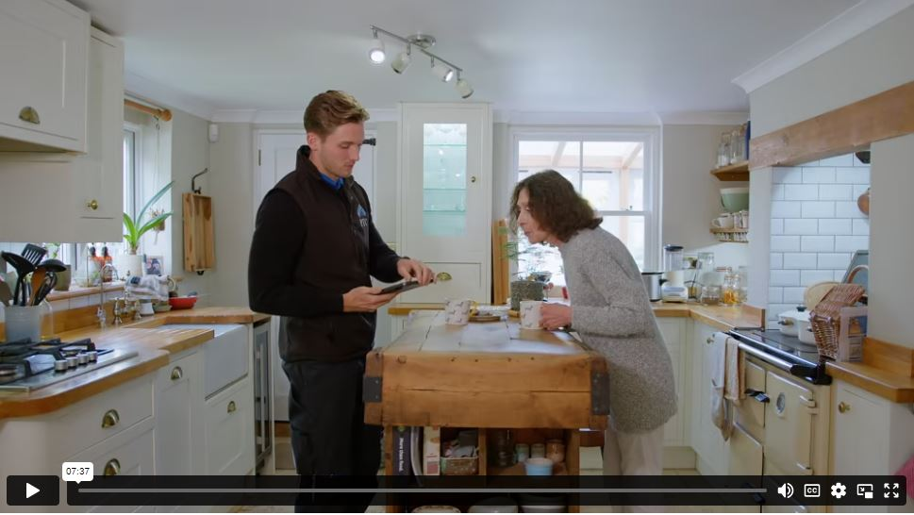
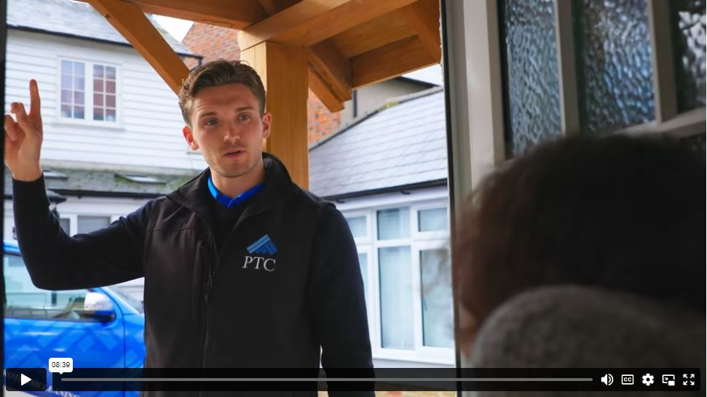
Showcase Videos
Short residents video here

Slide 19
Outputs Delivered
XXX Radio Reach
2 Market research surveys conducted
XXX Printed directory Reach
3 Face To Face Events
XX video Views
20 e-Learning modules completed
XXX Email marketing Reach
Xxx Resources downlaoded
Xxx Podcast Listens
Xxx Social Media Reach
Notes:
Figures to be added

Slide 20
Building Consumer Confidence - Legacy
French Translation
Businesses receive certification
Social Media
Microsite
Podcasts
Resources
Videos
Notes:
Consumer confidence may be starting to recover from the pandemic but it will take a lot of effort to return to pre pandemic levels. The resources we have produced for the project will not be shut down. They will continue to be monitored for relevance and promoted to relevant businesses and groups for many years to further preserve the legacy of the Interreg funding in Kent.
The funding we received has allowed us to elevate the status and membership offering of our Trading Standards Checked members in the county and further promote safe local traders. The mediums used for this have all been designed to offer continual reinforcement of what available and how that benefits the end consumer. The resources we devised were as requested by our businesses, sought through market research and on the say so of our residents, offering best practice guidance on areas that would make them feel comfortable allowing trades into their homes again.
Now the project has ended, we will continue to promote consumer confidence through use of our vetted members all the while using the many resources and equipment we have produced through the project.

Slide 21
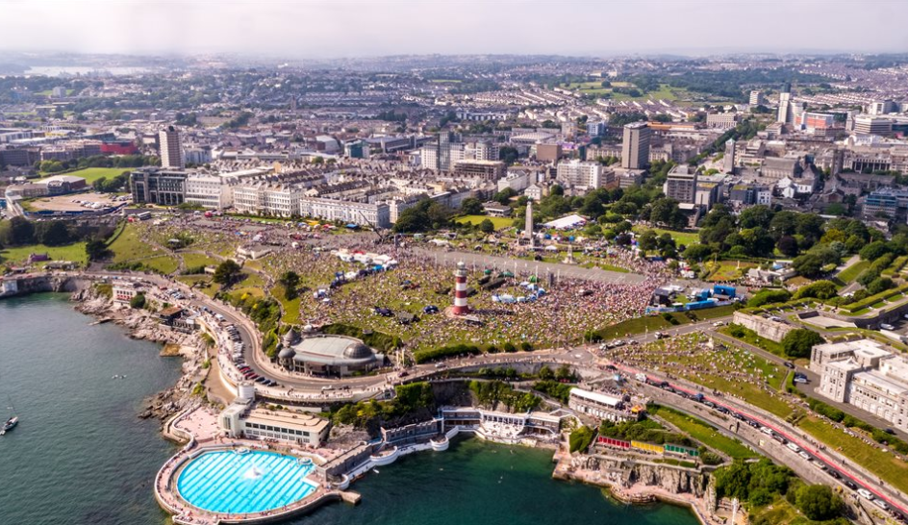
Inclusive Growth
Plymouth
Located in the South-West of England
Known as ‘Britain’s Ocean City’
Population of 264,000
Notes:
Plymouth is within the 20% most deprived local authority districts in England.
Census data shows a 3.2% increase in population in last 10 years

Slide 22
What is Inclusive Growth?
Plymouth’s definition:
‘To grow a prosperous economy that reduces inequality, is sustainable and truly serves the wellbeing of local people.’
Source: Plymouth Growth Board, Inclusive Growth Group
Notes:
Principles:
People in work should not be on benefits or use food banks in 1 of the richest countries in the world.
Economic growth/prosperity needs to benefit all and specifically reduce the wage gap between the richest and poorest.

Slide 23
Historically, Plymouth has:
Low business density
Low job density
Low skill, low wage roles
Less flexible working conditions
Notes:
2021 – 115,000 jobs within Plymouth LA.
Lower job density than the national average
Below average number of jobs in high-skills professions jobs but high than the average concentration of jobs in the public sector, manufacturing and retails

Slide 24
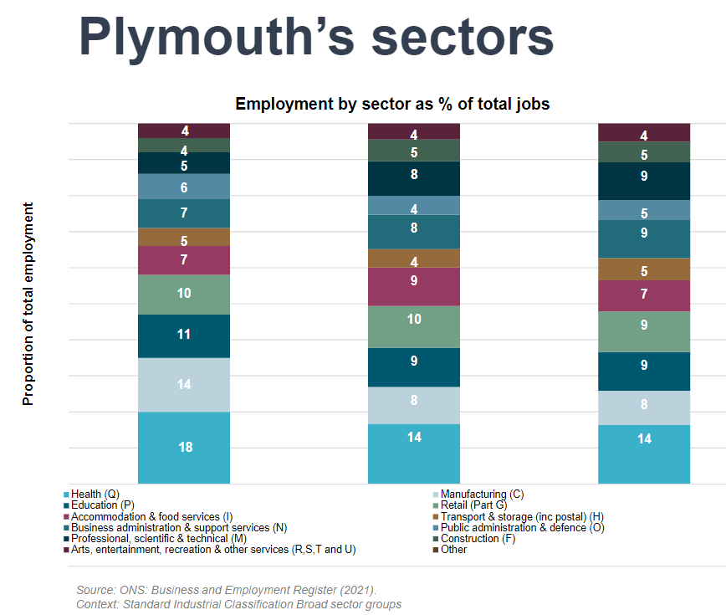
Employment sectors in Plymouth
Plymouth’s largest sectors for employment:
Health
Manufacturing
Education
Notes:
Health, Education and Manufacturing sectors are Plymouth's largest employers – more than the South West and Great Britain.

Slide 25
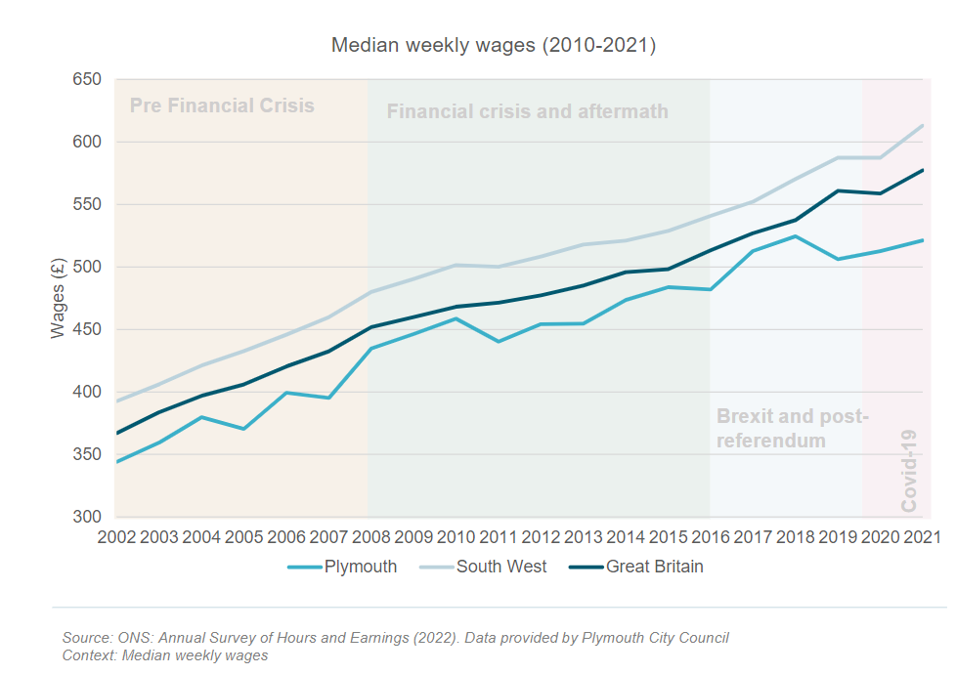
Weekly wages in Plymouth:
Notes:
Average weekly wages are consistently widening. Starting to close in 2017, the gap is again increasing.

Slide 26
Coming out of the Covid emergency….
3 key areas that disproportionately impacted the workforce:
People with caring responsibilities
People with health challenges
People from deprived backgrounds
A sustainable economy is not only about being successful but also breaking down barriers.
The economy needs to work for the employees of today as well as future employees.
Notes:
Caring responsibilities –impacting the way people were able to work
Sectors – high proportion of the wforce is in face-face and low pay sectors

Slide 27
Delivery comprised of:
Co-design groups with 10 pilot businesses in each theme, rolling out to a further 150 businesses.
These identified challenges and gaps in business support, which lead to workshops across the following themes:
-Supply chains
-Skills/workforce engagement
-Employment practices
-High street renaissance
-Climate emergency
Notes:
Our programme for inclusive economic growth was designed to build on the lessons of the emergency
Aim – enable businesses and organisations to understand and implement new practices to become more resilient.

Slide 28
Addressing Inclusive Growth through the Plymouth Charter
.
Notes:
Addressing the imbalances across Plymouth’s economy and finding ways to support Plymouth’s workforce and businesses

Slide 29
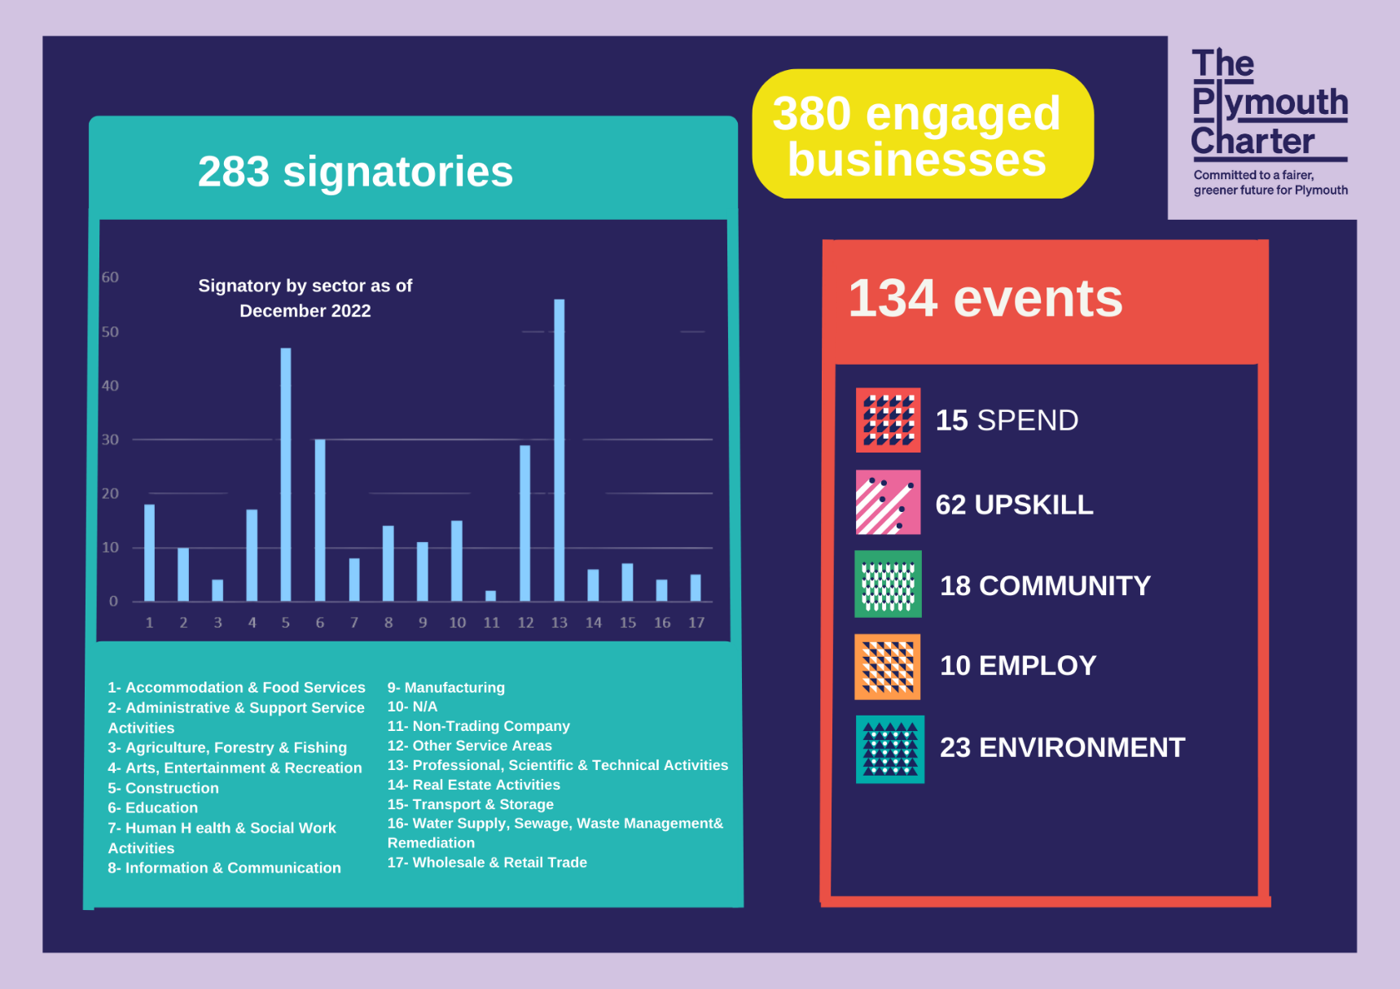
The Plymouth Charter – Key Achievements

Slide 30
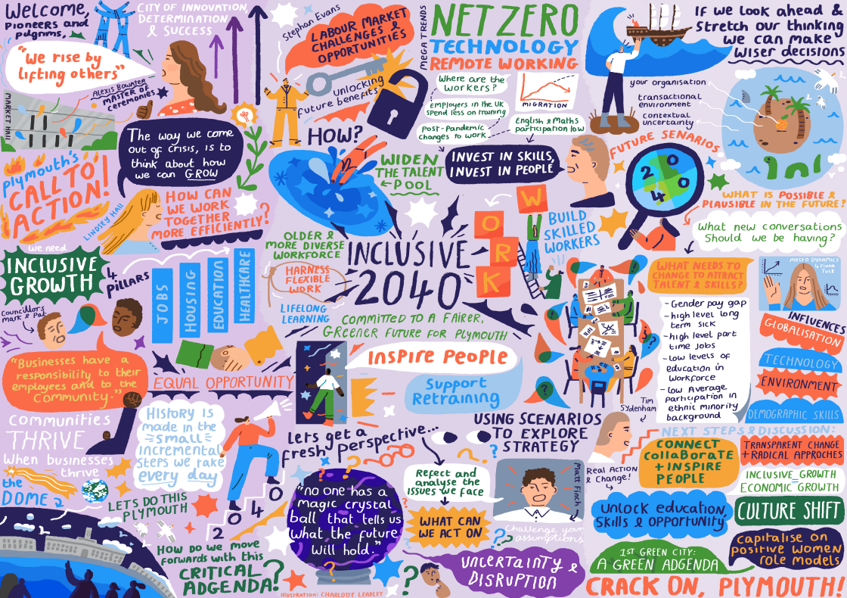
Inclusive 2040 – Data tells us what has been, not what the future could be…
The Inclusive 2040 Plymouth event focused on and explored the implications of current and emerging pressures on the businesses of Plymouth in relation to inclusivity. ​
Notes:
Participants contributed their knowledge and experience, but also the energy and commitment that they shared for a “fairer, greener future for Plymouth”. ​

Slide 31
Inclusive 2040 – Feedback from participants
.
Notes:
The event explored the current and emerging pressures on the key sectors within our city and mechanisms to understand and address their implications for inclusivity.
Run as a hybrid event, attendance from around 100 people in person and online

Slide 32
But what next?
What have we learnt?

Slide 33
Thank you!

